Slide 1

Python

Slide 2
Resources
https://docs.python.org/3/tutorial/index.html
https://www.w3schools.com/python/
https://www.tutorialspoint.com/python/index.htm
https://www.geeksforgeeks.org/python-programming-language-tutorial/ python extra
PRACTICE QUESTIONS
https://www.hackerrank.com/domains/python
https://libguides.ntu.edu.sg/python/numpyexercises (Python for Basic Data Analysis)
KAGGLE https://medium.com/@filip.sekan/8-websites-you-can-practice-python-for-data-science-for-free-584ede3fef8f
https://github.com/ajitmane36/Python-Practice/blob/main/Python%20Practice%20Notebook.ipynb
https://github.com/krishnaik06/Python-Practise-Problems/blob/main/Python%20Progamming%20(1).pdf
coding questions
https://prepinsta.com/interview-preparation/coding-interview-questions-in-python/
https://www.interviewbit.com/python-interview-questions/https://www.simplilearn.com/tutorials/python-tutorial/python-interview-questions
https://medium.com/@nikitasilaparasetty/python-interview-coding-questions-with-solutions-for-beginners-7f6d782defac
https://github.com/Tanu-N-Prabhu/Python/blob/master/Python%20Coding%20Interview%20Prep/Python%20Coding%20Interview%20Questions%20(Beginner%20to%20Advanced).md

Slide 3
What is Language?
what is Programming language?
Types of Programming language?
PYTHON
Then why Python?

Slide 4
Software and Tools
https://www.python.org/downloads/
https://code.visualstudio.com/download
https://colab.research.google.com/
https://jupyter.org/install
https://www.kaggle.com/datasets
Code Editors
python IDLE
CMD
Jupyter
vscode
pycharm
sublime
Online
google colab
kaggle
online python editor
https://www.programiz.com/python-programming/getting-started

Slide 5
Common cmd commands
OS Module in python for cmd
https://www.geeksforgeeks.org/os-module-python-examples/
Directory Navigation:
cd / dir / mkdir / rmdir / tree: Move between folders, list contents, and create/remove directories.
cls
copy / del / rename / xcopy: Move or remove files and directories.
cd
Changes your current directory.
cd /
Navigates to the root directory.
dir
Displays a list of files and subdirectories in a directory.
mkdir (or md)
Creates a new directory.
rmdir (or rd)
Removes a directory.
tree
Graphically displays the folder structure of a drive or path.
. root file
.. back file
Path setup, environment setup(optional or later)
https://www.geeksforgeeks.org/most-useful-cmd-commands-in-windows/
https://www.geeksforgeeks.org/python-sys-module/?ref=lbp

Slide 6
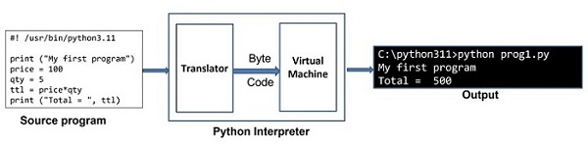
Python Interpreter
https://www.tutorialspoint.com/python/python_interpreter.htm
high level langauge low level language
intrepreter vs compiler
https://builtin.com/software-engineering-perspectives/compiler-vs-interpreter

Slide 7
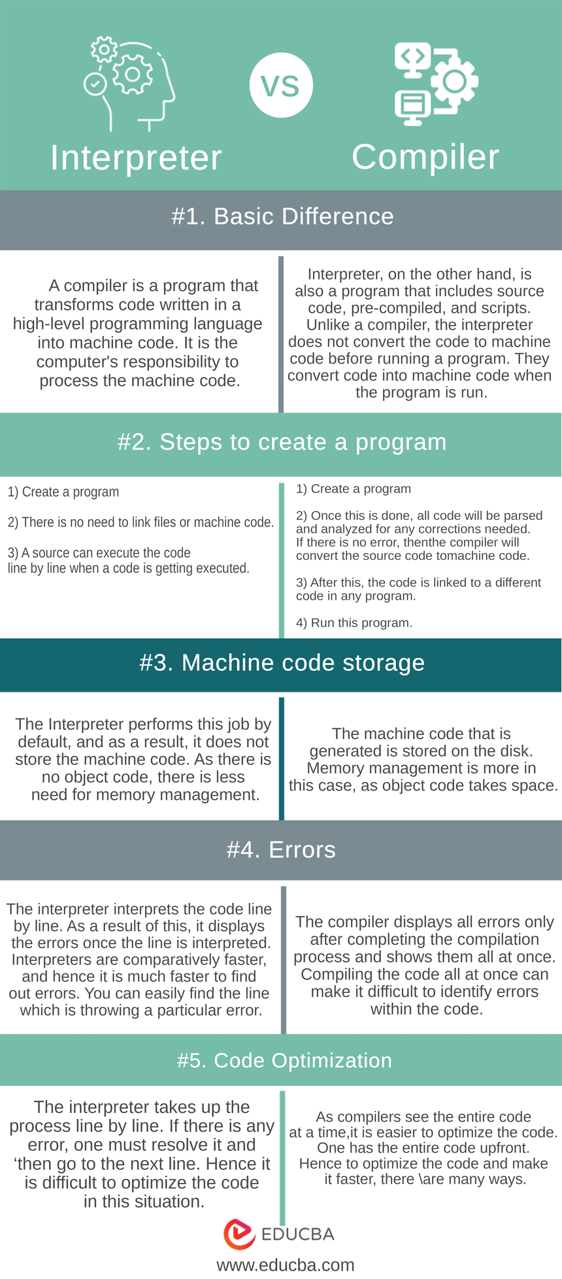
Conclusion
We have gone through many changes between the Interpreter vs Compiler. We can conclude after this above discussion that there are times when confident technical choices need to be relevant to your requirements. If a user wants speed and ease of development, you can mostly go for an interpreter-driven language. Also, all resources must be taken care of when any project is being started.
The revised sentence is more concise and adds the transitional phrase “while” to indicate the contrast between the two statements. Hence it is upon the user how to use both interpreters vs compilers.
https://www.tpointtech.com/compiler-vs-interpreter

Slide 8
Introduction to Python
What is Python
What are the feature of Python
The application areas of Python
Download and install Python
Execute Python program from command prompt and using IDLE
Assignment
https://www.tutorialspoint.com/python/python_history.htm

Slide 9
Python is a widely used high-level, interpreted programming language. It was created by Guido van Rossum in 1991 and further developed by the Python Software Foundation. It was designed with an emphasis on code readability, and its syntax allows programmers to express their concepts in fewer lines of code.
Python is Interpreted − Python is processed at runtime by the interpreter. You do not need to compile your program before executing it. This is similar to PERL and PHP.
Python is Interactive − You can actually sit at a Python prompt and interact with the interpreter directly to write your programs.
Python is Object-Oriented − Python supports Object-Oriented style or technique of programming that encapsulates code within objects.
Python is a Beginner's Language − Python is a great language for the beginner-level programmers and supports the development of a wide range of applications
https://www.geeksforgeeks.org/introduction-to-python/?ref=lbp

Slide 10
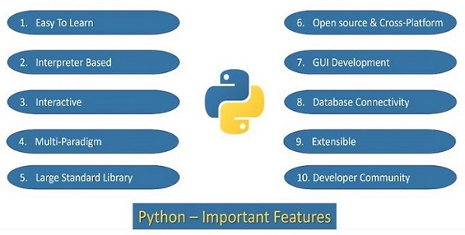
https://www.tutorialspoint.com/python/python_features.htm

Slide 11
https://www.tutorialspoint.com/python/python_vs_cpp.htm

Slide 12
Key Features of Python
Easy to Learn and Use: Python’s simple and readable syntax makes it beginner-friendly.
Cross-Platform Compatibility: Python runs seamlessly on Windows, macOS, and Linux.
Extensive Libraries: Includes robust libraries for tasks like web development, data analysis, and machine learning.
Dynamic Typing: Variable types are determined automatically at runtime, simplifying code writing.
Versatile: Supports multiple programming paradigms, including object-oriented, functional, and procedural programming.
Open Source: Python is free to use, distribute, and modify.
Python Comments
Comments in Python are the lines in the code that are ignored by the interpreter during the execution of the program.
Comments enhance the readability of the code.
Comment can be used to identify functionality or structure the code-base.
Comment can help understanding unusual or tricky scenarios handled by the code to prevent accidental removal or changes.
Comments can be used to prevent executing any specific part of your code, while making changes or testing.
# I am single line comment
""" Multi-line comment used
print("Python Comments") """
Here’s the “Hello World” program:
print("Hello, World!")
Output
How does this work:
print() is a built-in function in Python that tells the program to display something on the screen. We need to add the string in parenthesis of print() function that we are displaying on the screen.
“Hello, World!” is a string text that we want to display. Strings are always enclosed in quotation marks.

Slide 13
Famous Application Built using Python
YouTube: World’s largest video-sharing platform uses Python for features like video streaming and backend services.
Instagram: This popular social media app relies on Python’s simplicity for scaling and handling millions of users.
Spotify: Python is used for backend services and machine learning to personalize music recommendations.
Dropbox: The file hosting service uses Python for both its desktop client and server-side operations.
Netflix: Python powers key components of Netflix’s recommendation engine and content delivery systems (CDN).
Google: Python is one of the key languages used in Google for web crawling, testing, and data analysis.
Uber: Python helps Uber handle dynamic pricing and route optimization using machine learning.
Pinterest: Python is used to process and store huge amounts of image data efficiently

Slide 14
Indentation in Python
In Python, indentation is used to define blocks of code. It tells the Python interpreter that a group of statements belongs to a specific block. All statements with the same level of indentation are considered part of the same block. Indentation is achieved using whitespace (spaces or tabs) at the beginning of each line.
Example:
if10>5:print("This is true!")print("I am tab indentation")print("I have no indentation")
Explanation:
The first two print statements are indented by 4 spaces, so they belong to the if block.
The third print statement is not indented, so it is outside the if block.

Slide 15
Input and Output in Python
Understanding input and output operations is fundamental to Python programming. With the print() function, we can display output in various formats, while the input() function enables interaction with users by gathering input during program execution.
Taking input in Python
Python input() function is used to take user input. By default, it returns the user input in form of a string.
Example:
name=input("Enter your name: ")print("Hello,",name,"! Welcome!")
OutputEnter your name: GeeksforGeeks
Hello, GeeksforGeeks ! Welcome!
The code prompts the user to input their name, stores it in the variable “name” and then prints a greeting message addressing the user by their entered name.

Slide 16
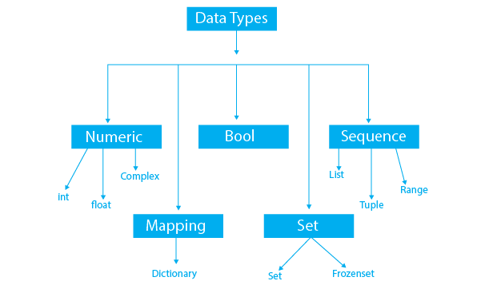
Data Types & Variable
Data Types
Variables
Identifiers
Literals
Type Casting
Comments
Command Line Arguments
Assignment
https://www.programiz.com/python-programming/variables-datatypes
https://www.tutorialspoint.com/python/index.htm

Slide 17
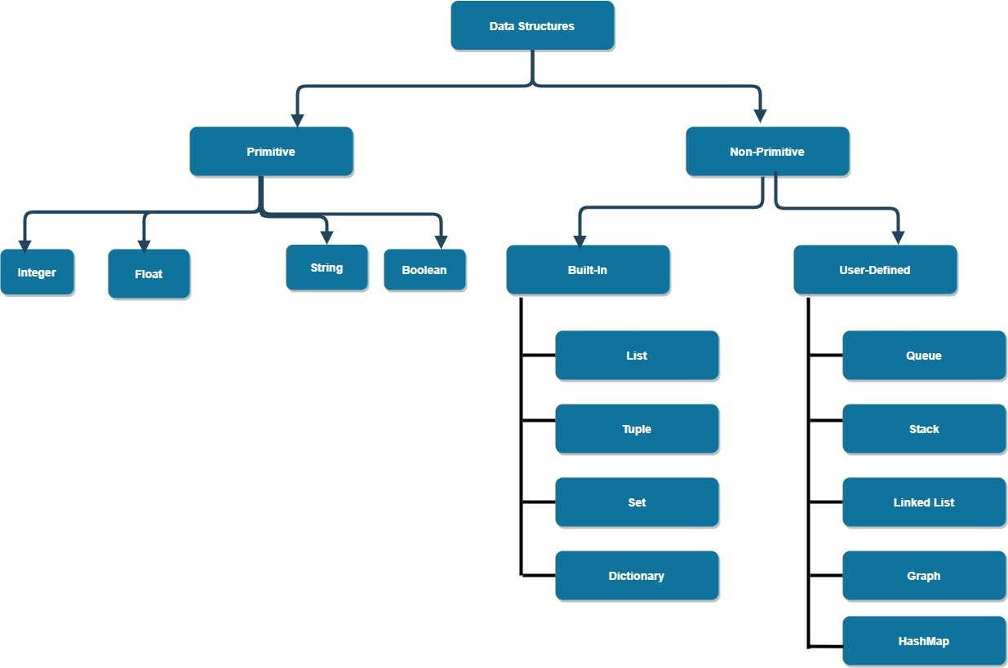

Slide 18
Data Types | Classes | Description
Numeric | int, float, complex | holds numeric values
String | str | holds sequence of characters
Sequence | list, tuple, range | holds collection of items
Mapping | dict | holds data in key-value pair form
Boolean | bool | holds either True or False
Set | set, frozenset | hold collection of unique items

Slide 19
Python data types categorize the values a variable can hold, including numeric (int, float, complex), text (str), sequence (list, tuple, range), binary (bytes, bytearray, memoryview), mapping (dict), set (set, frozenset), and boolean (bool).
Here's a more detailed breakdown:
1. Numeric Data Types:
int (Integer): Represents whole numbers (e.g., 10, -5, 0).
float (Floating-point number): Represents numbers with decimal points (e.g., 3.14, -2.5).
complex (Complex number): Represents numbers with a real and imaginary part (e.g., 2 + 3j).
2. Text Data Type:
str (String): Represents a sequence of characters (e.g., "Hello", "Python").
3. Sequence Data Types:
list (List): An ordered, mutable (changeable) collection of items (e.g., [1, 2, "a"]).
tuple (Tuple): An ordered, immutable (unchangeable) collection of items (e.g., (1, 2, "a")).
range (Range): Represents a sequence of numbers (e.g., range(5) generates 0, 1, 2, 3, 4).
4. Binary Data Types:
bytes (Bytes): Represents a sequence of bytes (e.g., b"Hello").
bytearray (Byte array): Represents a mutable sequence of bytes.
memoryview (Memory view): Allows access to the internal bytes of an object.
5. Mapping Data Type:
dict (Dictionary): An unordered collection of key-value pairs (e.g., {"name": "Alice", "age": 30}).
6. Set Data Types:
set (Set): An unordered collection of unique items (e.g., {1, 2, 3}).
frozenset (Frozen set): An immutable version of a set.
7. Boolean Data Type:
bool (Boolean): Represents truth values (either True or False).
8. None Type:
NoneType (None): Represents the absence of a value.

Slide 20
Python Variables
In programming, a variable is a container (storage area) to hold data. For example,10
Here, number is a variable storing the value 10.
Example: Assigning multiple values to multiple variables
Assigning values to Variables in Python
Changing the Value of a Variable in Python
site_name = 'programiz.pro'
print(site_name)
# assigning a new value to site_name
site_name = 'apple.com'
print(site_name)
https://www.programiz.com/python-programming/variables-constants-literals

Slide 21
In Python, an identifier is a name given to a variable, function, class, or other object, and it must follow specific rules: it can contain letters, digits, and underscores, but cannot start with a digit and is case-sensitive.
Here's a more detailed explanation:
What is an Identifier?
An identifier is essentially a name that you, as a programmer, give to something in your code, like a variable, function, or class.
It's how you refer to that entity within your program.
Think of it as a label or a handle that allows you to access and manipulate the object.
Example: my_variable, calculate_area, MyClass are all examples of identifiers.
Rules for Naming Identifiers:
Allowed Characters:
Letters (a-z, A-Z)
Digits (0-9)
Underscores (\_)
Not Allowed:
Cannot start with a digit
Cannot be a Python keyword (reserved word)
Case Sensitivity: Python is case-sensitive, meaning my_variable and My_variable are considered different identifiers.

Slide 22
Examples of Valid and Invalid Identifiers:
Identifier | Valid/Invalid | Reason
my_variable | Valid | Follows all rules
123_variable | Invalid | Starts with a digit
variable_name | Valid | Follows all rules
for | Invalid | "for" is a Python keyword
my-variable | Invalid | Contains a hyphen, which is not allowed
myVariable | Valid | Case sensitive, but valid
MyVariable | Valid | Case sensitive, but valid
Variables and Identifiers
A variable is a specific type of identifier that is used to store data.
You use an identifier to name a variable, and then assign a value to that variable.
Example: age = 30 (Here, age is the identifier/variable name, and 30 is the value assigned to it).
Variables can hold different types of data (numbers, text, lists, etc.).
Python is dynamically typed, meaning you don't need to declare the type of a variable; it's determined when you assign a value to it.
Best Practices
Choose descriptive names for your identifiers to make your code easier to understand.
Use lowercase letters for variable names, with words separated by underscores (e.g., user_name).
Follow consistent naming conventions within your project.

Slide 23
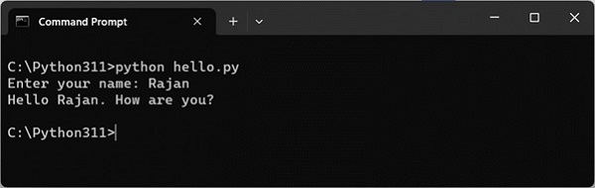
Comments
Command Line Arguments
name =input("Enter your name: ")
print("Hello {}. How are you?".format(name))
python script.py arg1 arg2 arg3
https://www.tutorialspoint.com/python/python_command_line_arguments.htm

Slide 24
Conditional Statement
Indentation in Python
Need of Conditional Statement
Comparison Operators
Logical operators
if...else statement
elif statementsators
Assignment
https://www.tutorialspoint.com/python/index.htm

Slide 25
Loops in Python
Loops in Python
range() function
Need of Loop
for loop
while loop
Continue, break and pass keyword
Nested loop
Mini Project
Assignment
https://www.tutorialspoint.com/python/index.htm

Slide 26
Loops in Python are used to repeat actions efficiently. The main types are For loops (counting through items) and While loops (based on conditions). Additionally, Nested Loops allow looping within loops for more complex tasks.
In Python, loops are used to repeatedly execute a block of code.
There are two main types of loops:
for loops
while loops

Slide 27
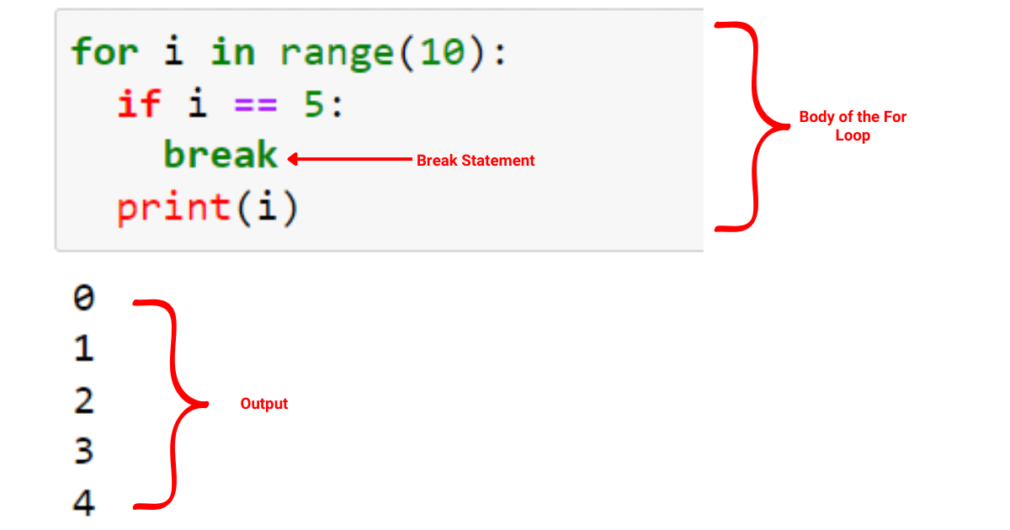

Slide 28
break: It terminates the loop prematurely if a certain condition is met. The program execution resumes at the next statement following the loop.
Python
foriin range(10):
if i == 5:
break
print(i)
# Output: 0 1 2 3 4
continue: It skips the rest of the current iteration of the loop and proceeds to the next iteration. The statements after continue in the current iteration are not executed.
Python
foriin range(10):
if i % 2 == 0:
continue
print(i)
# Output: 1 3 5 7 9
pass: It is a null operation, meaning it does nothing. It is used as a placeholder when a statement is syntactically required, but no action needs to be performed. It's often used when defining functions or classes that will be implemented later.
Python
defmy_function():
pass
classMyClass:
pass

Slide 29
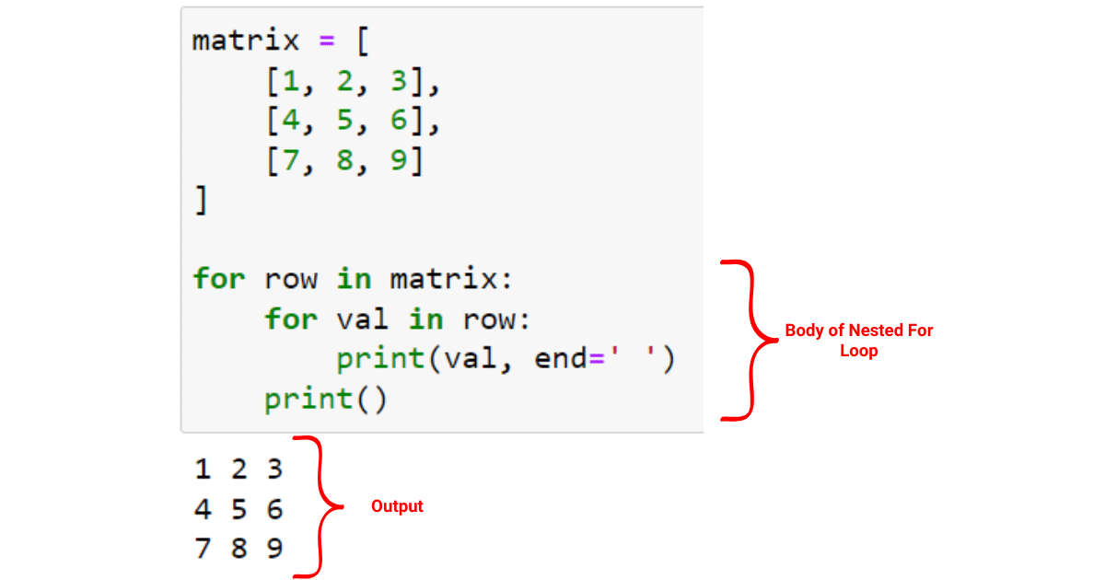
NESTED LOOPS

Slide 30
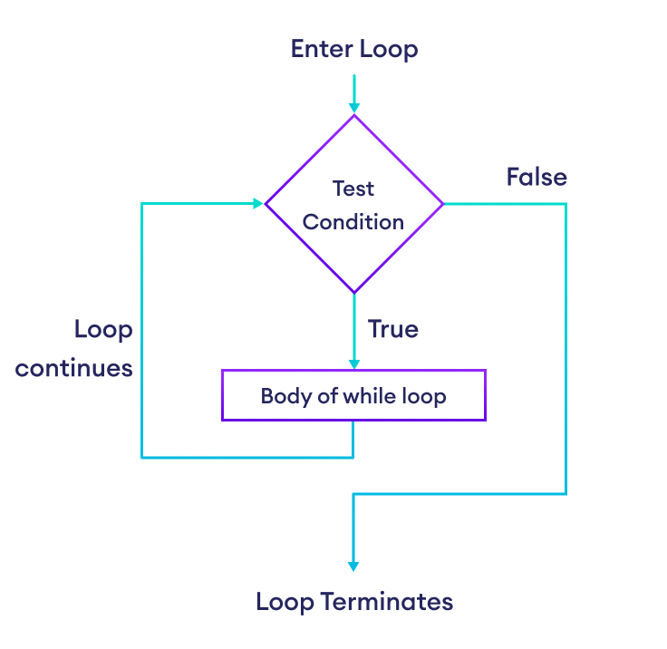
While Loop in Python
In Python, a while loop is used to execute a block of statements repeatedly until a given condition is satisfied. When the condition becomes false, the line immediately after the loop in the program is executed.
Python While Loop Syntax:
while expression:
statement(s)

Slide 31
How it works:
The while loop starts by evaluating the condition.
If the condition is True, the code inside the loop's block is executed.
After executing the code block, the condition is evaluated again.
This process repeats until the condition becomes False, at which point the loop terminates, and the program continues with the next statement after the loop.
Key Points:
Condition: The condition must be a Boolean expression that evaluates to either True or False.
Loop Body: The code block inside the loop must be indented.
Updating Variables: It's crucial to update variables used in the condition inside the loop to avoid infinite loops (where the condition never becomes False).
break Statement: The break statement can be used to exit the loop prematurely, even if the condition is still True.
continue Statement: The continue statement skips the current iteration and moves to the next one.
else Clause: A while loop can have an optional else clause, which is executed when the loop terminates normally (not by a break statement).
No do-while Loop: Python does not have a do-while loop.

Slide 32
Here are some real-life examples:
1. User Input Validation:
A program might need to repeatedly ask the user for input until a valid response is given.
For example, prompting for a username until it meets certain criteria (e.g., minimum length, no spaces).
whileTrue:
username = input("Enter username (at least 5 characters, no spaces): ")
if len(username) >= 5and""notin username:
break
else:
print("Invalid username. Please try again.")
2. Countdown Timer:
A countdown timer can be implemented using a while loop that decrements a counter variable until it reaches zero.
time = 10
while time > 0:
print(f"Time remaining: {time}")
time -= 1
print("Time's up!")
3. Game Loops:
In games, a while loop is used to keep the game running until a certain condition is met (e.g., the player loses, the game is won).
game_over = False
whilenot game_over:
# game logic to update game state
# check if game over
if player_health <= 0:
game_over = True
print("Game Over!")
4. Continuous Data Processing:
A program might need to process data continuously, such as reading from a sensor or network stream.
The loop continues as long as new data is available.
Python
whileTrue:
data = read_sensor_data()
if data:
process_data(data)
else:
break
5. Menu-Driven Programs:
A program might present a menu to the user and repeatedly ask for input until the user chooses to exit.
Python
whileTrue:
print("Menu:")
print("1. Option 1")
print("2. Option 2")
print("3. Exit")
choice = input("Enter choice: ")
if choice == "1":
# do something
elif choice == "2":
# do something else
elif choice == "3":
break
else:
print("Invalid choice.")

Slide 33
More on Data types
String
List , List comprehensions
Multidimensional List | tuple , set
Dictionary
Mini Project
Assignment
https://www.tutorialspoint.com/python/index.htm
https://www.tutorialspoint.com/python/python_list_comprehension.htm
list1=[x for x inrange(1,21)if x%2==0]
print(list1)
https://python101.pythonlibrary.org/chapter6_comprehensions.html

Slide 34
A string in Python is a sequence of characters. It's a fundamental data type used to represent text. Strings are immutable, meaning their content cannot be changed after creation.
String Literals:
Strings are created using single quotes ('), double quotes ("), or triple quotes (''' or """).
Single and double quotes are interchangeable.
Triple quotes allow multi-line strings and can include both single and double quotes without escaping.
String Operations:
Concatenation: Strings can be joined using the + operator.
Indexing: Individual characters can be accessed using square brackets [] with zero-based indexing.
Slicing: Substrings can be extracted using slicing [start:end:step].
Length: The len() function returns the number of characters in a string.
Comparison: Strings can be compared using ==, !=, <, >, <=, and >=. Comparison is based on the ASCII value of the characters.
Indexing:
Negative Indexing:
Slicing:
Python Strings are Immutable
Python Multiline String
Python String Operations
Iterate Through a Python String
Python String Length
String Membership Test
Methods of Python String
https://www.programiz.com/python-programming/string

Slide 35
String Methods:
Python provides numerous built-in methods for string manipulation. Some common methods include:
lower(): Converts a string to lowercase.
upper(): Converts a string to uppercase.
strip(): Removes leading and trailing whitespace.
split(): Splits a string into a list of substrings based on a delimiter.
join(): Concatenates a list of strings into a single string using a specified separator.
replace(): Replaces occurrences of a substring with another substring.
find(): Returns the index of the first occurrence of a substring.
startswith(): Checks if a string starts with a specified prefix.
endswith(): Checks if a string ends with a specified suffix.
Methods | Description
upper() | Converts the string to uppercase
lower() | Converts the string to lowercase
partition() | Returns a tuple
replace() | Replaces substring inside
find() | Returns the index of the first occurrence of substring
rstrip() | Removes trailing characters
split() | Splits string from left
startswith() | Checks if string starts with the specified string
isnumeric() | Checks numeric characters
index() | Returns index of substring

Slide 36
String Formatting:
Python offers several ways to format strings, including:
C-style formatting: Uses the % operator with format specifiers like %s for strings, %d for integers, and %f for floats.
format() method: Uses placeholders denoted by curly braces {}.
f-strings (formatted string literals): Introduced in Python 3.6, f-strings provide a concise and readable way to embed expressions within string literals using curly braces {} prefixed with f.
Escape Sequences in Python
Escape Sequence | Description
\\ | Backslash
\' | Single quote
\" | Double quote
\a | ASCII Bell
\b | ASCII Backspace
\f | ASCII Formfeed
\n | ASCII Linefeed
\r | ASCII Carriage Return
\t | ASCII Horizontal Tab
\v | ASCII Vertical Tab
\ooo | Character with octal value ooo
\xHH | Character with hexadecimal value HH
example = "He said, "What's there?""
print(example) # throws error
name = 'Cathy'
country = 'UK'
print(f'{name} is from {country}')
https://www.programiz.com/python-programming/string-interpolation

Slide 37
str() Parameters
The str() method takes three parameters:
object - whose string representation is to be returned
encoding - that the given byte object needs to be decoded to (can be UTF-8, ASCII, etc)
errors - a response when decoding fails (can be strict, ignore, replace, etc)
Note: There are six types of errors: strict, ignore, replace, xmlcharrefreplace, namereplace, backslashreplace. The default error is strict.
str() Syntax
The syntax of str() is:
str(object, encoding='utf-8', errors='strict')
Here, encoding and errors parameters are only meant to be used when the object type is bytes or bytearray.
# declare a byte object
b = bytes('pythön', encoding='utf-8')
# convert a utf-8 byte object to ascii with errors ignored
print(str(b, encoding='ascii', errors='ignore'))
# convert a utf-8 byte object to ascii with strict error
print(str(b, encoding='ascii', errors='strict'))
https://www.programiz.com/python-programming/methods/built-in/str

Slide 38
📝 1. Text Cleaning & Formatting
Q: Given a messy user input like " HeLLo, WOrlD!!! ", clean and standardize it to "hello, world".
python
CopyEdit
# Remove extra spaces and punctuation, convert to lowercase.
📧 2. Email Validation
Q: Write a function that checks if a string is a valid email (contains '@' and '.' after '@').
python
CopyEdit
# Example: "user@example.com" → Valid # "userexample.com" → Invalid
🔁 3. Reverse Words in a Sentence
Q: Reverse the words in "I love Python programming" to get "programming Python love I".
# Use string split and join
🔄 4. Check for Palindrome
Q: Write a function to check if a string is a palindrome (same forwards and backwards), ignoring case and spaces.
# "A man a plan a canal Panama" → True
🔡 5. Count Vowels and Consonants
Q: Count how many vowels and consonants are in a given sentence.
# Input: "Data Science" # Output: Vowels: 5, Consonants: 6
📦 6. Compress a String
Q: Compress a string like "aaabbcccc" to "a3b2c4".
# Apply run-length encoding logic
🔍 7. Most Frequent Word
Q: Given a paragraph, return the word that appears most frequently (ignore case and punctuation).
python
CopyEdit
# Use dictionary to count word frequency
🔁 8. Remove Duplicate Characters
Q: Write a function that removes repeated characters from a string, keeping only the first occurrence.
python
CopyEdit
# Input: "programming" # Output: "progamin"
🔢 9. Extract Numbers from String
Q: From a string like "Order #1234: Total $56.78", extract the number 1234 and 56.78.
python
CopyEdit
# Use regex or string methods
🧩 10. Anagram Checker
Q: Write a function to check if two strings are anagrams (same letters in different order).
python
CopyEdit
# "listen" and "silent" → True # "hello" and "world" → False
🎨 11. Capitalize Each Word
Q: Convert a string like "python is awesome" into "Python Is Awesome".
💳 12. Masking Sensitive Information
Q: Given a credit card number like "1234-5678-9012-3456", mask all but the last 4 digits.
python
CopyEdit
# Output: "****-****-****-3456"
⏱️ 13. Check Substring with Time Efficiency
Q: Write a function that checks if a short string exists inside a long document and returns the index.
📅 14. Date Format Conversion
Q: Convert "2025-06-17" to "17th June, 2025" using string slicing and formatting.
🛑 15. Forbidden Words Filter
Q: Replace all bad words from a string with "***" from a given list (e.g., ["bad", "ugly"]).

Slide 39
Python List
In Python, lists allow us to store multiple items in a single variable. For example, if you need to store the ages of all the students in a class, you can do this task using a list.
Lists are similar to arrays (dynamic arrays that allow us to store items of different data types) in other programming languages.
List Characteristics
In Python, lists are:
Ordered - They maintain the order of elements.
Mutable - Items can be changed after creation.
Allow duplicates - They can contain duplicate values.
multiple datatypes data can store
Create a Python List
List Items of Different Types
student = ['Jack', 32, 'Computer Science', [2, 4]]
Access List Elements(Negative Indexing
Slicing of a List in Python
Omitting Start and End Indices in Slicing
Add Elements to a Python List
Add Elements at the Specified Index
https://www.programiz.com/python-programming/list

Slide 40
Slide 1: Introduction to Python Lists
A list stores multiple items in a single variable.
Example:
ages = [19, 26, 29] print(ages) # Output: [19, 26, 29]
Lists can store different data types:
student = ['Jack', 32, 'CS', [2, 4]]
🧠 Slide 2: Key Characteristics of Lists
✅ Ordered – Items have a defined order
✅ Mutable – Items can be changed
✅ Allow Duplicates
✅ Can contain mixed data types
🔍 Slide 3: Accessing List Elements
Use indexing (starts from 0):
languages = ['Python', 'C++', 'Java'] print(languages[0]) # Python
Negative Indexing:
print(languages[-1]) # Java print(languages[-3]) # Python
✂️ Slide 4: List Slicing
my_list = ['p', 'r', 'o', 'g', 'r', 'a', 'm'] print(my_list[2:5]) # ['o', 'g', 'r'] print(my_list[:3]) # ['p', 'r', 'o'] print(my_list[5:]) # ['a', 'm']
➕ Slide 5: Adding Elements to a List
append() – Add at end
insert(index, value) – Add at position
extend(iterable) – Merge with another iterable
fruits = ['apple'] fruits.append('banana') fruits.insert(1, 'orange')
🔁 Slide 6: Updating and Changing Elements
Change by assigning new value using index
python
CopyEdit
colors = ['Red', 'Green'] colors[0] = 'Blue'
🗑️ Slide 7: Removing Elements
remove(value) – Delete specific value
del – Delete by index or range
del names[1:3]
📏 Slide 8: List Length and Iteration
Get length: len(list)
Loop through list:
for fruit in fruits: print(fruit)
Method | Description
append() | Add to end
insert() | Insert at index
remove() | Remove value
extend() | Add items from iterable
pop() | Remove and return item by index
clear() | Remove all elements
index() | First index of value
count() | Count occurrences
sort() | Sort list
reverse() | Reverse order
copy() | Shallow copy of list
📌 Slide 10: Extra Features (Optional)
list() function to convert other types
List Comprehension:
squares = [x*x for x inrange(5)]
enumerate() – Add index while looping
https://github.com/pik1989/PythonforDS/blob/main/Lists.ipynb

Slide 41
Description
Remove SPSS from input_list=['SAS', 'R', 'PYTHON', 'SPSS'] and add 'SPARK' in its place.
Description
Convert a list ['Pythons syntax is easy to learn', 'Pythons syntax is very clear'] to a string using ‘&’. The sample output of this string will be: Pythons syntax is easy to learn & Pythons syntax is very clear
Note that there is a space on both sides of '&' (as usual in English sentences).
How will I extract Python from the nested list
input_list = [['SAS','R'],['Tableau','SQL'],['Python','Java']]

Slide 42
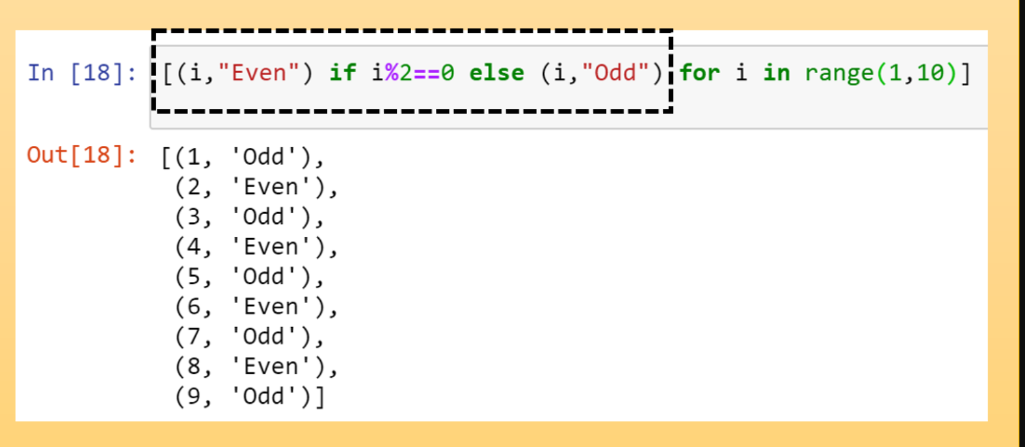

Slide 43
🔢 1. List Practice Questions
📋 Grocery List App:
Create a program to maintain a grocery list. Allow users to add, remove, and view items from the list.
📦 Shipment Tracker:
Given a list of product delivery dates, filter only the delayed shipments (i.e., date > today).
🎞️ Recent Movies Watchlist:
From a list of movies watched by a user, remove duplicates while preserving order.
📊 Sales Data Analysis:
Given a list of daily sales numbers, calculate the average, max, and min sales.
🧳 Packing Helper:
Given a list of travel items, create separate lists for clothing, electronics, and toiletries based on keywords.

Slide 44
🔢 List – Interview Questions
❓ How is a list different from an array in other languages?
❓ What is the time complexity of inserting and deleting elements in a list?
❓ How can you remove duplicates from a list while maintaining order?
❓ How would you reverse a list without using reverse()?
❓ How do list comprehensions work? Write one to square even numbers from 1 to 10.
❓ How do lists behave when passed to functions — by value or by reference?
❓ How do you deep copy a list of lists?
❓ What is the difference between append(), extend(), and insert()?

Slide 45
Python generators are a type of iterable that produce values lazily, one at a time, using the yield keyword instead of return. This characteristic makes them highly memory-efficient, especially when dealing with large datasets or potentially infinite sequences, as they don't store the entire sequence in memory simultaneously.
Key characteristics of Python generators:
Lazy Evaluation:
Values are generated only when requested, typically during iteration (e.g., in a for loop or when next() is called on the generator object).
Memory Efficiency:
By yielding values one by one, generators avoid the need to create and store a complete list or other data structure in memory, which is crucial for performance and resource management with large data volumes.
State Preservation:
When a yield statement is encountered, the generator's state (including local variables and execution point) is saved. When the generator is resumed, it continues execution from where it left off.
Creation:
Generator Functions: Defined like regular functions but contain one or more yield statements.
Generator Expressions: A concise way to create generators, similar to list comprehensions but using parentheses instead of square brackets (e.g., (x for x in range(10))).
Example of a Generator Function:
Python
defcount_up_to(n):
i = 0
while i < n:
yield i
i += 1
# Using the generator
fornumin count_up_to(5):
print(num)
Benefits of using generators:
Reduced Memory Usage:
Essential for handling large datasets or streaming data.
Improved Performance:
Lazy evaluation can lead to faster execution times when not all elements of a sequence are needed immediately.
Simplified Code:
Can make code more readable and easier to manage by encapsulating iteration logic.
Handling Infinite Sequences:
Generators can represent sequences that are theoretically infinite, as values are produced on demand.
geeksforgeeks.org/python/difference-between-iterator-vs-generator/

Slide 46
Table of difference between Iterator vs Generators
Iterator | Generator
Class is used to implement an iterator | Function is used to implement a generator.
Local Variables aren't used here. | All the local variables before the yield function are stored.
Iterators are used mostly to iterate or convert other objects to an iterator using iter() function. | Generators are mostly used in loops to generate an iterator by returning all the values in the loop without affecting the iteration of the loop
Iterator uses iter() and next() functions | Generator uses yield keyword
Every iterator is not a generator | Every generator is an iterator
def sq_numbers(n):
for i in range(1, n+1):
yield i*i
a = sq_numbers(3)
print("The square of numbers 1,2,3 are : ")
print(next(a))
print(next(a))
print(next(a))
a = [0, 5, 10, 15, 20]
for i in a:
if i % 2 == 0:
print(str(i)+' is an Even Number')
else:
print(str(i)+' is an Odd Number')
https://www.geeksforgeeks.org/python/difference-between-iterator-vs-generator/

Slide 47
TUPLE
Slide 6: Tuple Length and Iteration
Get length using len():
len(('BMW', 'Ford')) # Output: 2
Loop through tuple:
for item in fruits: print(item)
🔎 Slide 7: Tuple with One Item
Use a comma after the item:
single = ('hello',) print(type(single)) # tuple
Without comma:
python
CopyEdit
not_tuple = ('hello') # type: str
✅ Slide 8: Check Existence of Item
Use in keyword:
fruits = ('apple', 'banana') print('banana'in fruits) # True
❌ Slide 9: Deleting a Tuple
Entire tuple can be deleted:
tup = (1, 2, 3) del tup print(tup) # ❌ Error: tuple not defined
📚 Slide 10: Tuple Use Cases
Used when:
Data should not change
Ensuring data integrity
Can be used as dictionary keys
Common in:
Function return values
Unpacking multiple values
🐍 Slide 1: Introduction to Python Tuples
A tuple is similar to a list.
Major Difference: Tuples are immutable (cannot be changed after creation).
Defined using parentheses ().
numbers = (1, 2, -5) print(numbers)
🛠️ Slide 2: Creating Tuples
With parentheses:
tup = ('a', 'b', 'c')
Using tuple() constructor:
names = tuple(('Jack', 'Maria', 'David'))
✅ Tuples can contain mixed data types and nested structures.
📌 Slide 3: Tuple Characteristics
✅ Ordered – Maintains item order
❌ Immutable – Cannot be changed after creation
✅ Allows Duplicates
✅ Supports nested tuples
Example:
python
CopyEdit
tup = ('John', 25, ('CS', 90))
🔍 Slide 4: Accessing Tuple Elements
Access using indexing:
languages = ('Python', 'Swift', 'C++') print(languages[0]) # Python print(languages[2]) # C++
Index starts from 0
🚫 Slide 5: Immutability in Tuples
Tuples cannot be changed.
cars = ('BMW', 'Tesla') cars[0] = 'Nissan' # ❌ Error
You cannot:
Add items
Change items
Delete individual items (only entire tuple)

Slide 48
📐 2. Tuple Practice Questions
📍 Geo Coordinates Lookup:
Create a list of tuples storing (city_name, (latitude, longitude)) and find the nearest city given a point.
💼 Employee Records:
Each employee is represented by a tuple (ID, Name, Salary). Write a function to sort by salary.
🧾 Billing Items:
Store purchased items in tuples as (item_name, quantity, price_per_unit) and calculate total bill.
📚 Library Database:
Create a tuple for each book: (title, author, year) and write a function to filter books before 2000.
🚇 Subway Station Info:
Given a list of stations as tuples (station_name, line_number), group stations by line.

Slide 49
📐 Tuple – Interview Questions
❓ Why are tuples immutable and how is this beneficial in Python?
❓ When would you use a tuple instead of a list?
❓ Can a tuple contain mutable objects like lists? What happens then?
❓ What is the performance difference between list and tuple?
❓ How can a tuple be used as a key in a dictionary?
❓ How do you unpack tuples in Python? Can you use the * operator?

Slide 50
Introduction to Python Sets
A set is an unordered collection of unique elements.
No duplicates allowed.
Ideal for storing distinct values, e.g., student IDs, usernames, etc.
🧱 Slide 2: Creating a Python Set
student_id = {112, 114, 116, 118, 115} vowel_letters = {'a', 'e', 'i', 'o', 'u'} mixed_set = {'Hello', 101, -2, 'Bye'}
✅ Elements can be of different data types
❌ Elements cannot be mutable like lists or dictionaries
🛑 Slide 3: Creating an Empty Set
empty_set = set() # ✅ creates a set empty_dict = {} # ❌ creates a dictionary print(type(empty_set)) # <class 'set'> print(type(empty_dict)) # <class 'dict'>
🧬 Slide 4: Duplicate Elements are Ignored
numbers = {2, 4, 6, 6, 2, 8} print(numbers) # {2, 4, 6, 8}
➕ Slide 5: Add & Update Items
# add single item numbers = {21, 34} numbers.add(12) # add multiple items companies = {'Lacoste'} companies.update(['apple', 'google'])
✅ Use add() for one item
✅ Use update() for iterable items
🔄 Slide 6: Remove Elements from Set
languages = {'Swift', 'Java', 'Python'} languages.discard('Java') # Removes 'Java' safely languages.remove('Go') # ❌ KeyError if not present
🧩 discard() – no error if element not found
🔥 remove() – throws error if element not found
🔁 Slide 7: Loop & Length of Set
for fruit in {"Apple", "Peach", "Mango"}: print(fruit) even_numbers = {2, 4, 6} print(len(even_numbers)) # Output: 3
⚙️ Slide 8: Common Set Functions
🔣 Slide 9: Set Operations
🔗 Union
A | B or A.union(B)
Combines all unique elements from both sets
🎯 Intersection
A & B or A.intersection(B)
Only common elements
➖ Difference
A - B or A.difference(B)
Items in A but not in B
🔁 Symmetric Difference
A ^ B or A.symmetric_difference(B)
All items except those common in both
✔Slide 10: Compare Sets
A = {1, 2, 3} B = {3, 2, 1} print(A == B) # True
✅ Order doesn’t matter, only elements do
Function | Description
all() | True if all items are true or set is empty
any() | True if any item is true
len() | Number of elements
max() / min() | Max/Min value
sum() | Sum of numeric items
sorted() | Returns a sorted list, not a set

Slide 51
🔁 3. Set Practice Questions
👥 Unique Users on Website:
From a list of user visits, extract the unique user IDs.
📚 Common Books Between Friends:
Given 2 sets of books owned by two friends, find:
Books they both own
Books only one of them owns
🎯 Target Market Analysis:
Given sets of customers who bought "Product A" and "Product B", identify:
Customers who bought both
Customers who bought only one
🎮 Game Badge Tracker:
Store unlocked game achievements using sets and find out which ones are still locked (difference).
🏫 Class Attendance Tracker:
Track students present each day using sets. Find students who attended all days.
https://github.com/pik1989/PythonforDS/blob/main/Sets.ipynb

Slide 52
🧊 4. Frozenset Practice Questions
📁 Immutable Access Rights:
Create a frozenset of read-only access permissions and try adding/removing permissions to understand immutability.
🏢 Department Tags in Reports:
Store tags as frozensets for each report and compare them to detect changes in department names across versions.
🎨 Color Palette Combos:
Store color combinations as frozensets. Check if a combination already exists (ignoring order).
🏷️ Product Attribute Sets:
Store product features as frozensets and group products with identical features.
🧪 Chemical Compound Detection:
Use frozensets to store atomic components of chemical compounds. Identify compounds with the same components.

Slide 53
🔁 Set – Interview Questions
❓ What are the advantages of using a set in Python?
❓ How do sets handle duplicate values?
❓ What are common operations on sets? (union, intersection, difference)
❓ How would you find common users between two social networks using sets?
❓ Are sets ordered? Can you index into a set?
❓ What is the time complexity of lookup in a set?
🧊 Frozenset – Interview Questions
❓ What is a frozenset and when would you use it?
❓ How does a frozenset differ from a normal set?
❓ Can frozensets be used as keys in dictionaries? Why or why not?
❓ What operations can and cannot be performed on a frozenset?
❓ Can a frozenset contain mutable objects like a list?

Slide 54
WHY DICTIONARY
5. 🛒 Problem: Shopping Cart System
Statement:
Simulate a shopping cart where product names are keys and quantities are values. Allow adding, updating, and deleting items.
Why Dictionary?
Products can be accessed and updated efficiently by name.
6. 🎓 Problem: Count Student Enrollments per Course
Statement:
Given a list of (student, course) pairs, find how many students enrolled in each course.
Why Dictionary?
Each course is a key; increment count as you parse pairs.
11. 👨‍👩‍👧‍👦 Problem: Family Tree Tracker
Statement:
Track parents of each person in a dataset like {child: [father, mother]}.
Why Dictionary?
Efficient lookup and storage of relationships.
12. 🌍 Problem: Country–City Directory
Statement:
Store a mapping of countries to a list of their major cities.
Why Dictionary?
Key = Country name, Value = list of cities.

Slide 55
📌 What is a Dictionary?
A dictionary is a built-in Python data structure that stores key-value pairs.
It is:
Unordered (before Python 3.7)
Mutable
Keys are unique and immutable (e.g., string, number, tuple)
Values can be of any type (mutable or immutable)
🛠️ Creating a Dictionary
# Method 1: Using curly braces my_dict = {'name': 'Alice', 'age': 25, 'city': 'Delhi'} # Method 2: Using dict() constructor my_dict = dict(name='Alice', age=25, city='Delhi')
🧾 Accessing Dictionary Elements
print(my_dict['name']) # Alice print(my_dict.get('age')) # 25
⚠️ get() is safer — returns None if key doesn't exist, while [] gives KeyError.
➕ Adding & Updating Elements
# Add new item my_dict['gender'] = 'Female' # Update existing key my_dict['age'] = 26 # Using update() method my_dict.update({'city': 'Mumbai', 'country': 'India'})
🧮 Dictionary Functions
Function | Description
len(d) | Returns number of key-value pairs
str(d) | Returns string representation of dictionary
type(d) | Returns type (<class 'dict'>)
🔧 Dictionary Methods
✅ Membership Test
'dob'in my_dict # Check if key exists 'name'notin my_dict # Check if key does NOT exist
🔄 Merge Two Dictionaries
# Python 3.5+ d1 = {'a': 1, 'b': 2} d2 = {'b': 3, 'c': 4} merged = {**d1, **d2} # OR using update() d1.update(d2)
🧪 Dictionary from List of Tuples
pairs = [('a', 1), ('b', 2)] d = dict(pairs)
🚫 Invalid Dictionary Examples
# ❌ Mutable types like list cannot be keys d = {[1, 2]: "Invalid"} # TypeError # ✅ Valid: Tuples as keys (immutable) d = {(1, 2): "Valid"}
📚 Real-World Use Cases
Storing configuration settings
Caching (e.g., memoization in recursion)
Word frequency counter
Database-style records (key as column, value as data)
🎯 Practice Challenge
Q: Write a function to merge two dictionaries and return the result.
defmerge_dicts(d1, d2): return {**d1, **d2}
Method | Description
d.get(k) | Returns value of key k or None if key doesn't exist
d.keys() | Returns all keys as a view
d.values() | Returns all values as a view
d.items() | Returns all key-value pairs as tuples
d.update(d2) | Adds/updates key-value pairs from d2
d.pop(k) | Removes key k and returns its value
d.popitem() | Removes and returns the last inserted key-value pair
d.clear() | Removes all items
d.copy() | Returns a shallow copy of dictionary
➖ Removing Items
python
CopyEdit
# Remove specific item my_dict.pop('city') # Remove using del del my_dict['age'] # Remove last inserted item (Python 3.7+) my_dict.popitem() # Clear entire dictionary my_dict.clear()
🔁 Looping Through Dictionary
python
CopyEdit
# Loop through keys for key in my_dict: print(key) # Loop through values for value in my_dict.values(): print(value) # Loop through key-value pairs for key, value in my_dict.items(): print(key, value)

Slide 56
📘 5. Dictionary Practice Questions
👤 User Profile System:
Store users in a dictionary with username as key and another dictionary as value (e.g., name, age, email).
🛒 Shopping Cart System:
Store items in a cart with item name as key and quantity as value. Allow adding, updating, and removing items.
💰 Bank Transactions:
Dictionary of accounts with account number as key and balance as value. Implement deposit and withdrawal functions.
🌦️ Weather Log:
Store daily weather as {date: temperature}. Add a function to get average temp over a date range.
📊 Survey Response Counter:
From a list of survey responses, count the occurrence of each response using a dictionary.

Slide 57
📘 Dictionary – Interview Questions
❓ How is a dictionary implemented internally in Python?
❓ Can dictionary keys be of any type? What are the requirements?
❓ What is the difference between dict.get() and dict[] for key lookup?
❓ How can you merge two dictionaries in Python 3.9+?
❓ How do you handle missing keys safely?
❓ How do you sort a dictionary by value or by key?
❓ Can you store complex data structures (like a list of dicts) in a dictionary?
❓ When and why would you use defaultdict?

Slide 58
💡 Bonus Challenge
Create a Python program that:
Uses a list of dictionaries to store users,
Each dictionary has a frozenset of their interests,
Tracks unique interest sets using a set of frozensets,
And stores user login info using a dictionary of tuples (username, (email, last_login)).

Slide 59
Function and Modules
Defining and calling function
return statement
Types of Argument-default,variable length
Variable Scope - Global vs Local
Recursive function
Lambda, filter, map, reduce
Need of Module
What is module
Built in Module
User defined Module
Assignment
https://www.tutorialspoint.com/python/index.htm

Slide 60
Functions in Python are named blocks of organized, reusable code designed to perform specific tasks. They are fundamental to modularizing and structuring Python programs, promoting code reusability and readability.
Key Aspects of Python Functions:
Definition: Functions are defined using the def keyword, followed by the function name, parentheses (which may contain parameters), and a colon. The function's body is indented.
Python
def greet(name):
print(f"Hello, {name}!")
Calling: Functions are executed by calling them by their name followed by parentheses, potentially passing arguments if the function expects parameters.
Python
greet("Alice") # Calls the greet function with "Alice" as an argument
Arguments and Parameters:
Parameters: Variables defined within the function's parentheses that receive input values when the function is called.
Arguments: The actual values passed to the function when it is called.
Return Values:
Functions can return a value using the return statement. If no return statement is present, the function implicitly returns None.
Python
def add(a, b):
return a + b
result = add(5, 3) # result will be 8
Types of Functions:
Built-in Functions: Functions provided by Python's standard library, readily available for use (e.g., print(), len(), sum()).
User-defined Functions: Functions created by the programmer to perform specific tasks.
Functions from Modules: Functions defined within modules that need to be imported before use (e.g., math.sqrt() from the math module).
Advantages:
Modularity: Breaks down complex programs into smaller, manageable units.
Reusability: Avoids code duplication by allowing the same code block to be used multiple times.
Readability and Maintainability: Improves code organization and makes it easier to understand and modify.

Slide 61
📌 1. Defining and Calling a Function
A function is a reusable block of code that performs a specific task when called.
🔹 Syntax:
deffunction_name(parameters): # code block return value # (optional)
🔹 Example:
defgreet(name): print(f"Hello, {name}!") greet("Amit") # Output: Hello, Amit!
✅ Use Case:
Avoid repeating code (DRY principle).
Structure code into smaller, manageable parts.
🌍 Real-World Scenario:
A banking application uses a function calculate_interest(principal, rate, time) to compute interest multiple times.
📌 2. return Statement
return sends a value back to the function caller.
🔹 Example:
defsquare(x): return x * x result = square(5) # result = 25
✅ Use Case:
To send computed results to other parts of the program.
🌍 Real-World Scenario:
In an e-commerce app, get_discounted_price() returns the final price after applying a discount.

Slide 62
📌 3. Types of Arguments
🔸 a. Default Arguments
🔹 Definition:
Arguments with default values that are used if no value is passed.
defwelcome(name="Guest"): print("Welcome", name)
✅ Use Case: Set fallback values.
🌍 Real-World: Showing “Hello, Guest” on a website if user name is not available.
🔸 b. Variable-Length Arguments
🔹 *args → non-keyworded
deftotal(*numbers): returnsum(numbers)
✅ Use Case: Sum of any number of inputs.
🌍 Real-World: Billing system that handles multiple items dynamically.
🔹 **kwargs → keyworded
defuser_profile(**details): print(details)
✅ Use Case: Accept flexible key-value inputs.
🌍 Real-World: User profile with optional details like name, email, dob, etc.

Slide 63
📌 4. Variable Scope: Local vs Global
🔹 Local Variable:
Defined and accessible only inside the function.
deflocal_example(): x = 10 print(x)
🔹 Global Variable:
Defined outside any function and accessible everywhere.
x = 5 defmodify(): global x x = 20
✅ Use Case: Keep variables confined to functions unless sharing is necessary.
🌍 Real-World: In a game, score might be a global variable, but temporary bonuses are local.

Slide 64
Lambda functions
✅ Advantages of lambda in Python:
Compact – Reduces code length.
Faster to write for simple operations.
Useful in functional programming (e.g., map, filter, reduce).
Perfect for GUI or web callback functions.
Improves readability when logic is very simple.
✅ lambda vs def in Python
Feature | lambda Function | def Function
Syntax | One-liner, anonymous | Multi-line, named
Use Case | Small, throwaway functions | Reusable and complex logic
Return Statement | Implicit (always returns an expression) | Explicit (return keyword)
Function Name | Anonymous (no name unless assigned) | Always has a name
Number of Expressions | Only one expression allowed | Multiple expressions/statements allowed
Readability | More readable for short logic | Better for complex logic
Scope & Reuse | Used once or inline | Can be reused, tested, and maintained
Best With | map(), filter(), sorted(), GUI callbacks | General function definition

Slide 65
is_even = lambda x: x % 2 == 0
print(is_even(10)) # Output: True
print(is_even(7)) # Output: False
Example: Immediate use without assignment
python
CopyEdit
print((lambda x: "Even"if x % 2 == 0else"Odd")(10)) # Output: Even print((lambda x: "Even"if x % 2 == 0else"Odd")(7)) # Output: Odd
Or for a Boolean result:
python
CopyEdit
print((lambda x: x % 2 == 0)(10)) # Output: True (even) print((lambda x: x % 2 == 0)(7)) # Output: False (odd)

Slide 66
Here are the key advantages of using lambda functions in Python, especially in real-world scenarios:
✅ 1. Concise Syntax
Lambda functions allow writing small, throwaway functions in a single line.
No need to define full function with def.
Example:
✅ 2. Useful for Functional Programming
Works seamlessly with functions like map(), filter(), reduce().
Example:
✅ 3. Inline Use – No Need to Name
Perfect for one-time use without polluting the namespace.
Example:
✅ 4. Improves Readability (for small logic)
In places like sorting or filtering, the logic is self-contained and easy to read.
Example:
✅ 5. Common in GUI/Web Development
Frequently used for callbacks, e.g., button actions or event handlers.
Example (Tkinter):
✅ 6. Reduces Boilerplate
No need to write full function definitions for simple logic—saves time and lines of code.
✅ 7. Dynamic Function Behavior
You can generate functions on-the-fly inside loops or based on input.
Example:
Would you like a comparison table between lambda and def functions too?

Slide 67
Here are some real-world use cases where Python lambda functions are commonly used, especially for concise, inline operations in data processing, UI applications, and web development:
✅ 1. Sorting Employee Records by Salary (Dictionary Sorting)
Scenario: You have a list of employees with their details. You want to sort them by salary.
python
CopyEdit
employees = [ {"name": "Alice", "salary": 50000}, {"name": "Bob", "salary": 60000}, {"name": "Charlie", "salary": 40000} ] # Sort by salary using lambda sorted_employees = sorted(employees, key=lambda x: x['salary']) print(sorted_employees)
✅ 2. Filtering Customers with High Purchases
Scenario: You want to filter customers who spent more than ₹10,000.
python
CopyEdit
customers = [8000, 12000, 1500, 18000, 7000] # Filter using lambda high_spenders = list(filter(lambda x: x > 10000, customers)) print(high_spenders) # Output: [12000, 18000]
✅ 3. Transforming Product Prices (e.g., add 18% GST)
Scenario: You need to apply GST on a list of base prices.
python
CopyEdit
prices = [100, 200, 500] # Add 18% GST prices_with_gst = list(map(lambda x: x * 1.18, prices)) print(prices_with_gst)
✅ 4. GUI Button Action in Tkinter
Scenario: You create buttons dynamically and want each to call a different function using a lambda.
python
CopyEdit
import tkinter as tk root = tk.Tk() for i inrange(5): tk.Button(root, text=f"Button {i}", command=lambda i=i: print(f"Button {i} clicked")).pack() root.mainloop()
✅ 5. Web Frameworks (e.g., Flask Route with Inline Logic)
Scenario: You want to quickly handle a route with minimal logic in Flask.
python
CopyEdit
from flask import Flask app = Flask(__name__) @app.route("/double/<int:num>") defdouble(num): returnstr((lambda x: x * 2)(num))
✅ 6. Pandas – Create New Column Based on Condition
Scenario: In a DataFrame, classify age as "Adult" or "Minor".
python
CopyEdit
import pandas as pd df = pd.DataFrame({'Name': ['A', 'B', 'C'], 'Age': [17, 25, 15]}) df['Status'] = df['Age'].apply(lambda x: "Adult"if x >= 18else"Minor") print(df)

Slide 68
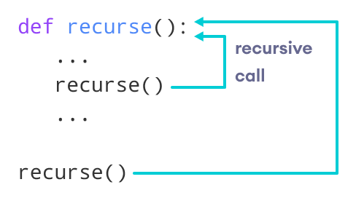
A function that calls itself to solve smaller instances of a problem.
deffactorial(n): if n == 0: return1 return n * factorial(n - 1)
✅ Use Case: Divide a problem into smaller problems.
🌍 Real-World: Navigating a file system tree or solving mathematical problems like Fibonacci series.
Python Recursion
Recursion is the process of defining something in terms of itself.
A physical world example would be to place two parallel mirrors facing each other. Any object in between them would be reflected recursively.
Python Recursive Function
In Python, we know that a function can call other functions. It is even possible for the function to call itself. These types of construct are termed as recursive functions.
The following image shows the working of a recursive function called recurse.
Following is an example of a recursive function to find the factorial of an integer.
Factorial of a number is the product of all the integers from 1 to that number. For example, the factorial of 6 (denoted as 6!) is 1*2*3*4*5*6 = 720.

Slide 69
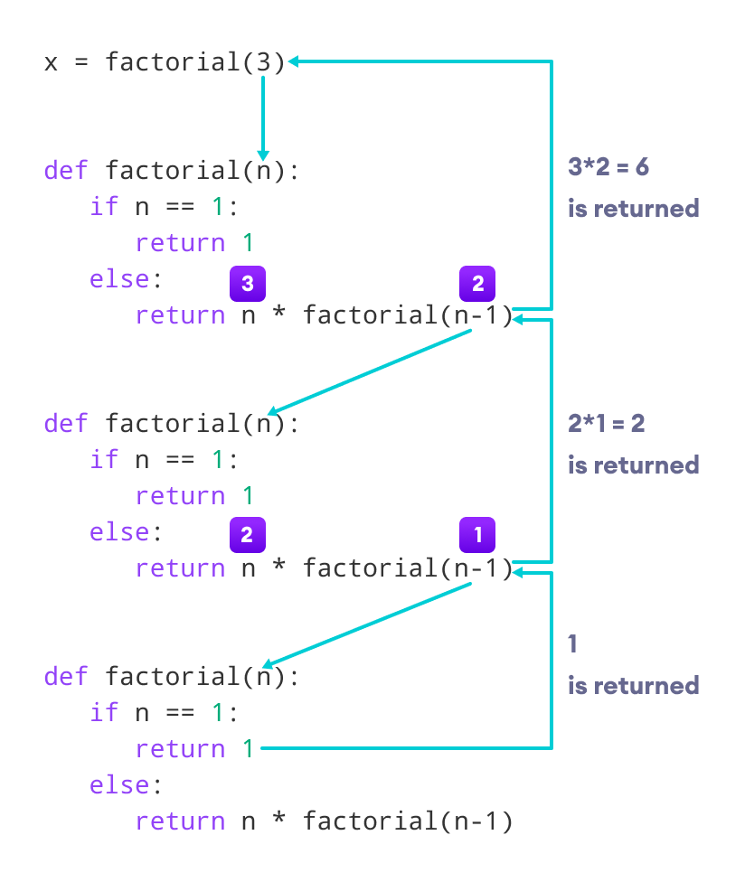
def factorial(x):
"""This is a recursive function
to find the factorial of an integer"""
if x == 1:
return 1
else:
return (x * factorial(x-1))
num = 3
print("The factorial of", num, "is", factorial(num))

Slide 70
Advantages of Recursion
Recursive functions make the code look clean and elegant.
A complex task can be broken down into simpler sub-problems using recursion.
Sequence generation is easier with recursion than using some nested iteration.
Disadvantages of Recursion
Sometimes the logic behind recursion is hard to follow through.
Recursive calls are expensive (inefficient) as they take up a lot of memory and time.
Recursive functions are hard to debug.
Python Program to Find Sum of Natural Numbers Using Recursion
Python Program to Display Fibonacci Sequence Using Recursion

Slide 71
Built-in Functions
Python abs()
Python any()
Python all()
Python enumerate()
Python staticmethod()
Python filter()
Python eval()
Python format()
Python hash()
Python input()
Python id()
Python isinstance()
Python map()
Python property()
Python range()
numbers = [1,2,3,4]
# returns the square of a number
def square(number):
return number * number
# apply square() to each item of the numbers list
squared_numbers = map(square, numbers)
# converting to list for printing
result = list(squared_numbers)
print(result)
# Output: [1,4,9,16]
Python map()
REDUCE
FILTERS
Python zip()
SUPER()
Python map() Function
The map() function executes a given function to each element of an iterable (such as lists, tuples, etc.).
🔸 Lambda Function (Anonymous)
square = lambda x: x * x print(square(4)) # 16
✅ Use Case: Short one-line functions without def.

Slide 72
map() Syntax
map() Arguments
The map() function takes two arguments:
function - a function that is applied to each element of an iterable.
iterables - iterables such as lists, tuples, etc.
Note: We can pass more than one iterable to the map() function.
map() Return Value
The map() function returns a map object, which can be easily converted to lists, tuples, etc.
https://www.programiz.com/python-programming/methods/built-in/map

Slide 73
🔁 1. map() Function
Purpose: Applies a given function to all items in an iterable (like a list).
Syntax: map(function, iterable)
✅ Example 1: Square Each Number in a List
numbers = [1, 2, 3, 4, 5]
squared = list(map(lambda x: x ** 2, numbers))
print(squared)
Output:
Explanation: lambda x: x**2 squares each number in the list.
✅ Example 2: Convert List of Strings to Uppercase
words = ['apple', 'banana', 'cherry']
upper_words = list(map(str.upper, words))
print(upper_words)
Output:
Explanation: str.upper converts each string in the list to uppercase.
✅ Example 3: Convert Temperatures from Celsius to Fahrenheit
celsius = [0, 10, 20, 30]
fahrenheit = list(map(lambda c: (c * 9/5) + 32, celsius))
print(fahrenheit)
Output:
Explanation: The lambda function applies the temperature conversion formula to each element.

Slide 74
🧹 3. filter() Function
Purpose: Filters items out of an iterable based on a condition (returns only items for which the function returns True).
Syntax: filter(function, iterable)
✅ Example 1: Filter Even Numbers
numbers = [1, 2, 3, 4, 5, 6]
evens = list(filter(lambda x: x % 2 == 0, numbers))
print(evens)
Output:
Explanation: Keeps numbers that are divisible by 2.
✅ Example 2: Filter Strings Longer Than 3 Characters
words = ['cat', 'lion', 'dog', 'elephant']
long_words = list(filter(lambda w: len(w) > 3, words))
print(long_words)
Output:
Explanation: Keeps strings whose length is more than 3.
✅ Example 3: Filter Positive Numbers
nums = [-10, 5, -2, 3, 0]
positives = list(filter(lambda x: x > 0, nums))
print(positives)
Output:
Explanation: Keeps numbers greater than 0.

Slide 75
🔽 2. reduce() Function
Purpose: Applies a rolling computation to sequential pairs of values in an iterable.
Syntax: reduce(function, iterable)
Note: You need to import it from functools.
✅ Example 1: Sum All Elements in a List
from functools import reduce
numbers = [1, 2, 3, 4]
total = reduce(lambda x, y: x + y, numbers)
print(total)
Output:
Explanation: Adds elements step-by-step: (((1+2)+3)+4)
✅ Example 2: Find Maximum in a List
numbers = [5, 9, 2, 8, 1]
maximum = reduce(lambda x, y: x if x > y else y, numbers)
print(maximum)
Output:
Explanation: Compares each pair and retains the larger number.
✅ Example 3: Multiply All Elements in a List
numbers = [1, 2, 3, 4]
product = reduce(lambda x, y: x * y, numbers)
print(product)
Output:
Explanation: Multiplies numbers step-by-step: (((1*2)*3)*4)
from functools import reduce
numbers = [1, 2, 3, 4, 5, 6]
even_sum = reduce(lambda x, y: x + y if y % 2 == 0 else x, numbers)
print(even_sum)
from functools import reduce
# Helper function to check if a number is prime
def is_prime(n):
if n < 2:
return False
for i in range(2, int(n**0.5) + 1):
if n % i == 0:
return False
return True
numbers = [1, 2, 3, 4, 5, 6, 7, 8, 9, 10]
# Sum prime numbers using reduce with if condition in lambda
prime_sum = reduce(lambda x, y: x + y if is_prime(y) else x, numbers)
print(prime_sum)

Slide 76
Function | Purpose | Returns
map() | Apply a function to all items | New iterable with transformed items
reduce() | Aggregate a list into a single value | Single result value
filter() | Select items meeting a condition | New iterable with selected items

Slide 77
Python Modules
As our program grows bigger, it may contain many lines of code. Instead of putting everything in a single file, we can use modules to separate codes in separate files as per their functionality. This makes our code organized and easier to maintain.
Module is a file that contains code to perform a specific task. A module may contain variables, functions, classes etc. Let's see an example,
Let us create a module. Type the following and save it as example.py
Import modules in Python
Note:
Python has tons of standard modules. You can check out the full list of Python standard modules and their use cases.
Standard modules can be imported the same way as we import our user-defined modules.
Python import with Renaming
IMPORT MATHS AS M

Slide 78
Python Package
A package is a container that contains various functions to perform specific tasks. For example, the math package includes the sqrt() function to perform the square root of a number.
While working on big projects, we have to deal with a large amount of code, and writing everything together in the same file will make our code look messy. Instead, we can separate our code into multiple files by keeping the related code together in packages.
Now, we can use the package whenever we need it in our projects. This way we can also reuse our code.

Slide 79
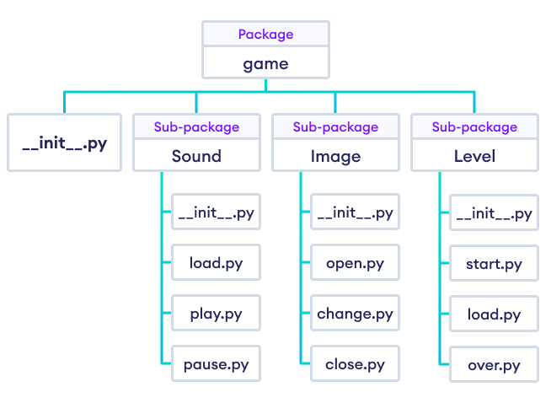
Package Model Structure in Python Programming
Suppose we are developing a game. One possible organization of packages and modules could be as shown in the figure below.

Slide 80
Importing module from a package
In Python, we can import modules from packages using the dot (.) operator.
For example, if we want to import the start module in the above example, it can be done as follows:i
import Game.Level.start
Now, if this module contains a function named select_difficulty(), we must use the full name to reference it.2
Game.Level.start.select_difficulty(2)
https://www.programiz.com/python-programming/package

Slide 81
📌 7. Need of Modules
🔹 Why Use Modules?
Reusability of code
Better code organization
Separation of concerns
🌍 Real-World: Banking system has modules for user, transaction, and loan.
📌 8. What is a Module?
A module is a file containing Python definitions and functions.
🔹 Example:
File: mymodule.py
defadd(x, y): return x + y
Usage:
import mymodule print(mymodule.add(2, 3))
📌 9. Built-in Modules
Examples:
math – mathematical operations
random – generate random numbers
datetime – handle date and time
os – interact with OS
import math print(math.sqrt(16)) # 4.0
📌 10. User-Defined Modules
🔹 How to Create:
Create a .py file with functions
Import it in another file
🌍 Real-World: Create sales.py, utils.py for your data analysis project.

Slide 82
Python Main function
What is the main() function in Python?
Some programming languages have a special function called main() which is the execution point for a program file. Python interpreter, however, runs each line serially from the top of the file and has no explicit main() function.
Python offers other conventions to define the execution point. One of them is using the main() function and the __name__ property of a python file.
What is __name__ in Python?
The __name__ variable is a special builtin Python variable that shows the name of the current module.
It has different values depending on where we execute the Python file. Let's look at an example.
Running Python File as a Script
Suppose we have a Python file called helloworld.py with the following content:
print(__name__)
if we run helloworld.py from the command line, then it runs as a Python script. We can run the Python program using the following command:
When we run the program as a script, the value of the variable __name__ is set to __main__. So the output of the following program will be:

Slide 83
VARIABLE SCOPE
Python Nonlocal Variables
In Python, the nonlocal keyword is used within nested functions to indicate that a variable is not local to the inner function, but rather belongs to an enclosing function’s scope.
This allows you to modify a variable from the outer function within the nested function, while still keeping it distinct from global variables.
Based on the scope, we can classify Python variables into three types:
Local Variables
Global Variables
Nonlocal Variables
example of how a global variable is created in Python.
# declare global variable
message = 'Hello'
def greet():
# declare local variable
print('Local', message)
greet()
print('Global', message)
# outside function
def outer():
message = 'local'
# nested function
def inner():
# declare nonlocal variable
nonlocal message
message = 'nonlocal'
print("inner:", message)
inner()
print("outer:", message)
outer()

Slide 84
Python Global Keyword
In Python, the global keyword allows us to modify the variable outside of the current scope.
It is used to create a global variable and make changes to the variable in a local context.
Example: Changing Global Variable From Inside a Function using global
# global variable
c = 1
def add():
# use of global keyword
global c
# increment c by 2
c = c + 2
print(c)
add()
# Output: 3
Access and Modify Python Global Variable
# global variable
c = 1
def add():
# increment c by 2
c = c + 2
print(c)
add()
Output
UnboundLocalError: local variable 'c' referenced before assignment
This is because we can only access the global variable but cannot modify it from inside the function.
The solution for this is to use the global keyword.

Slide 85
Rules of global Keyword
The basic rules for global keyword in Python are:
When we create a variable inside a function, it is local by default.
When we define a variable outside of a function, it is global by default. You don't have to use the global keyword.
We use the global keyword to modify (write to) a global variable inside a function.
Use of the global keyword outside a function has no effect.

Slide 86
QUESTIONS
Take value from users --> name ,roll_no , class , email, address
create a functions to store student details in dictonary --->dict = student_details{}
variable = name ,roll_no , class , email, address
{name:["a"],roll_no:[1] , class:[10] , email:[gmail.com], address :[]}

Slide 87
Object Oriented Programming
What are the feature of OOPs
What is Class, Attributes & Methods
What is Constructor and Destructor ?
What is Inheritance
Data Abstraction
What is Polymorphism
Assignment
python overloading (function overloading, operator overloading)
https://www.tutorialspoint.com/python/index.htm
https://www.geeksforgeeks.org/python/python-oops-concepts/ ---> teach from website

Slide 88
✅ Real-World Scenario: "Build a Student Management System"
🧩 Problem Statement (Non-OOP Way First)
“You are managing a coaching institute. You have to store and manage details of students: name, age, course, marks, etc. You also want to generate report cards, filter top performers, and update information.”
Start with how you’d do it using:
Lists and dictionaries (student1 = {"name": ..., "age": ...}).
Show how it gets messy as the number of students increases.
➡️ Introduce the problem of:
Repetition of code
Harder maintenance
Increased possibility of error

Slide 89
🧩 Real-World Problem: Student Management System
Let’s solve it without OOP, using lists and dictionaries.
✅ Without OOP (Using Dictionaries and Lists)
python
CopyEdit
# List of students, each student is a dictionary students = [ {"name": "Alice", "age": 20, "course": "Python", "marks": 85}, {"name": "Bob", "age": 21, "course": "Data Science", "marks": 90}, {"name": "Charlie", "age": 19, "course": "AI", "marks": 78} ] # Display all student details defshow_students(student_list): for student in student_list: print(f"Name: {student['name']}, Age: {student['age']}, Course: {student['course']}, Marks: {student['marks']}")
# Update marks defupdate_marks(student_list, name, new_marks): for student in student_list: if student["name"] == name: student["marks"] = new_marks print(f"Marks updated for {name}") return print("Student not found.") # Get top student defget_top_student(student_list): top = max(student_list, key=lambda x: x["marks"]) return top # Usage show_students(students) update_marks(students, "Alice", 95) print("Top Student:", get_top_student(students))
❌ Problems Without OOP:
Repeated structure ({"name", "age", "marks", ...} everywhere)
No encapsulation — direct access to all data
Adding behavior (methods) for each student is hard
Difficult to scale — imagine tracking 1,000 students with more fields and methods

Slide 90
✅ Now Introduce OOP (As previously shared)
➡️ Cleaner design
➡️ Reusable structure
➡️ Data + Behavior in one place (encapsulation)
➡️ Easy to extend (inheritance, polymorphism)

Slide 91
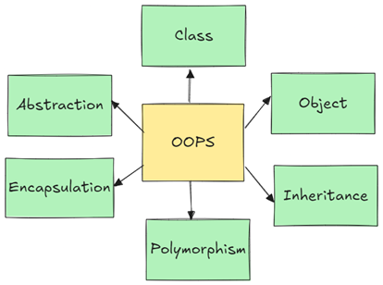
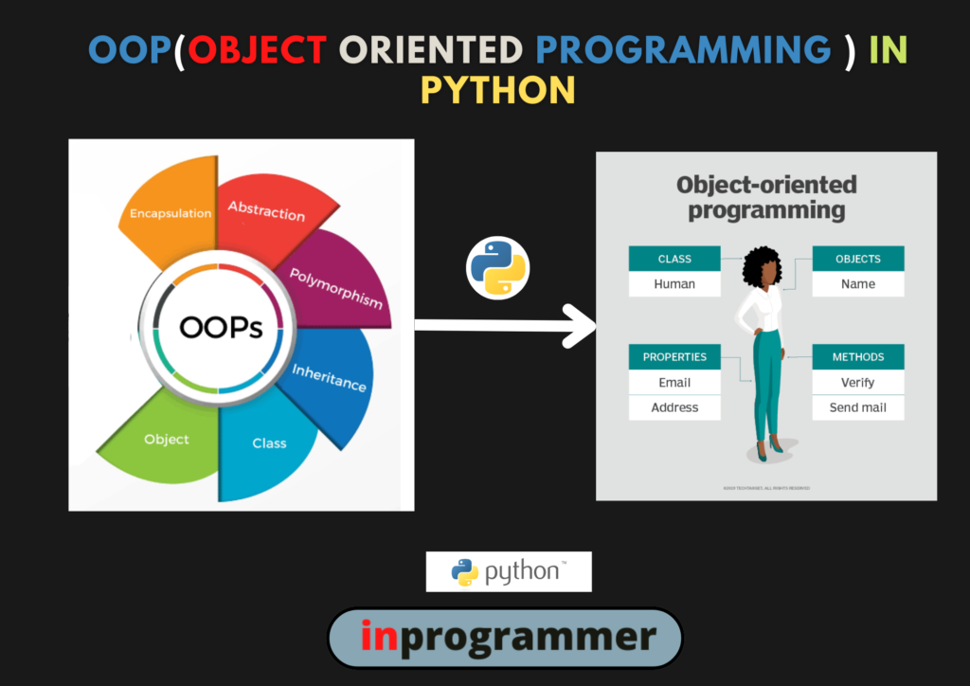
📌 What is OOP?
Object-Oriented Programming (OOP) is a programming paradigm that uses "objects" – instances of "classes" – to model real-world entities. It provides a structured and modular approach for software development.
Object-oriented programming (OOP) is a method of structuring a program by bundling related properties and behaviors into individual objects.

Slide 92
🌟 Features of OOP
Feature | Description | Real-World Analogy
Class & Object | Blueprint and instance of a blueprint | Blueprint of a Car vs Real Car
Encapsulation | Hides internal state and requires all interaction to be performed through methods | Mobile phone: We use buttons, not internal circuits
Inheritance | A class can inherit attributes and methods from another | Child inherits traits from parent
Polymorphism | Same function behaves differently for different objects | "Drive" function in Bike and Car
Abstraction | Hiding unnecessary details from the user | Driving a car without knowing engine internals

Slide 93
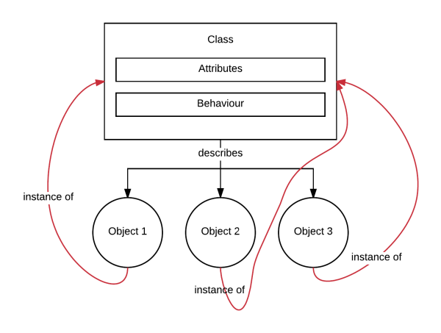
📦 What is a Class, Attributes & Methods
Class: A blueprint to create objects.
Attributes: Variables inside a class (data).
Methods: Functions inside a class (behavior).
# EXAMPLE
class Car:
# attributes
def __init__(self, brand, model):
self.brand = brand
self.model = model
# method
def start(self):
print(f"{self.brand} {self.model} is starting...")
# Create an object
mycar = Car("Toyota", "Camry")
mycar.start()

Slide 94
Classes & Objects:
Class:
The class can be defined as a collection of objects. A class is a blueprint for the object. It is a logical entity that has some specific attributes and methods. Class logically groups the data in such a way that code re-usability becomes easy.
Class is a template or blueprint for how to build an object. A class in python logically grouping of data and functions. An instance is a particular realization of a class.
A class is a prototype that defines state and behavior common to all objects of its kind python supports both class objects and instance objects.
In fact, everything in python is an object, including a class object. Classes describe data and provide methods to manipulate that data, all encompassed under a single object.
Objects:
An Object contains attributes: data attributes (or static attributes or variables) and dynamic behaviors called methods. In the UML diagram, objects are represented by 3-compartment boxes: name, data attributes, and methods

Slide 95
Methods:
The method is a function that is associated with an object. In python, a method is not unique to the class instance. Any object can have methods
Instance method:
an instance method is a very basic and easy method that we use regularly when we create classes in python. we should create an object of the class if we wanted to print the instance attributes or methods.
If we are using self as a function parameter or in front of a variable, that is nothing but the calling instance variable or method itself.
As we are working with instance variables, we use the self keyword.
Note: Instance variables are used with instance methods.
There are three types of methods in python. They are
Instance method
Class method
Static method
https://inprogrammer.com/object-oriented-programming-oops-in-python/

Slide 96
Class method:
There are two ways to create class methods in python:
Using classmethod(function)
Using @classmethod annotation
A class method can be called either using the class (such as C.f()) or using an instance (such as C().f()). The instance is ignored except for its class. If a class method is called from a derived class, the derived class object is passed as the implied first argument.
As we are working with ClassMethod we use the cls keyword. Class variables are used with class methods.
Static method:
A static method can be called without an object for that class, using the class name directly. If you want to do something extra with a class, we use static methods.
We can directly call the static method by directly calling it by its class name.

Slide 97
✅ Example:
classEmployee: def__init__(self, name): self.name = name print(f"Employee {self.name} created.") def__del__(self): print(f"Employee {self.name} deleted.") emp = Employee("John") del emp
📝 Output:
Employee John created. Employee John deleted.
🛠️ What is Constructor and Destructor?
✅ Constructor: __init__()
Special method called when an object is created.
✅ Destructor: __del__()
Called when an object is destroyed (mostly auto-handled by garbage collection).

Slide 98
Benefits of OOP in Python:
Modularity:
Classes help break down complex programs into smaller, manageable components.
Reusability:
Inheritance and polymorphism allow for code to be reused across different parts of a program or in different projects.
Maintainability:
Well-structured OOP code is easier to understand, debug, and update.
Flexibility:
Polymorphism and dynamic binding offer extensibility and the ability to modify behavior without altering existing code.
Real-world Modeling:
OOP facilitates a more intuitive representation of real-world entities and their relationships in code.

Slide 99
OOPs PILLARS
Inheritance
Polymorphism
Data Abstraction
Encapsulation

Slide 100
✅ Real-world Scenario:
Dog is a subclass of Animal.
✅ Code Example:
classAnimal: defspeak(self): print("Animal speaks") classDog(Animal): defbark(self): print("Dog barks") d = Dog() d.speak() # inherited d.bark() # own method
🧬 What is Inheritance?
Inheritance is a mechanism that allows us to inherit all the properties from another class. Acquiring base class properties and methods into a child class is known as inheritance.
The main advantage of this is re-usability and increases readability. Python supports single-level, multi-level and multiple inheritances. In python, the object is the parent class of all classes.
It generally means “inheriting or transfer of characteristics from parent to child class without any modification”. The new class is called the derived /child class and the one from which it is derived is called a parent/base class.
Python inheritance super function – super().
With inheritance, the super() function in python actually comes in quite handy. It allows us to call a method from the parent class.

Slide 101
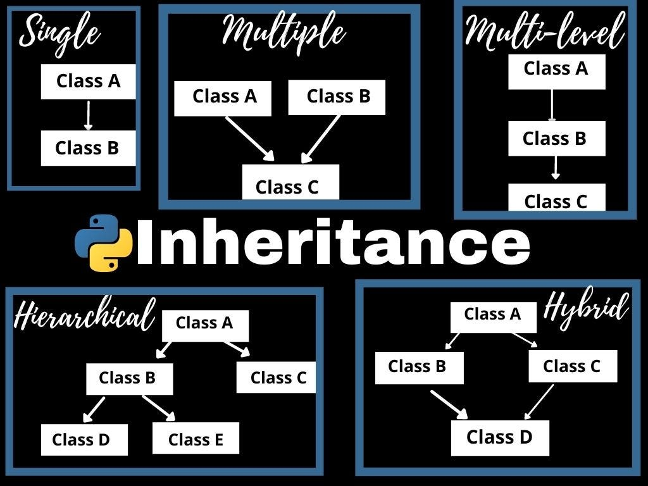
Different forms of inheritances:
Single level inheritance
Multi-level inheritance
Multiple inheritance
Hierarchical inheritance

Slide 102
🔒 Encapsulation in OOP
📖 Definition:
Encapsulation is the process of bundling data (attributes) and methods (functions) that operate on that data into a single unit, typically a class, and restricting direct access to some of the object's components.
This is done to:
Protect internal object state
Control modification using getters and setters
🧠 Real-world Analogy:
Think of a capsule or a mobile phone:
You use the phone to call or message (methods).
You don’t see or access the inner wiring (data is hidden).
You interact using buttons or screen (interface).
🔐 Access Modifiers in Python
Access Type | Prefix | Meaning
Public | None | Accessible from anywhere
Protected | _ | Suggests internal use only (not enforced)
Private | __ | Name mangled to prevent direct access

Slide 103
🧪 Python Example of Encapsulation
classBankAccount: def__init__(self, owner, balance): self.owner = owner # public self.__balance = balance # private # Getter method defget_balance(self): return self.__balance # Setter method defdeposit(self, amount): if amount > 0: self.__balance += amount else: print("Invalid amount") # Another method to demonstrate encapsulation defwithdraw(self, amount): if0 < amount <= self.__balance: self.__balance -= amount else: print("Insufficient funds or invalid amount")
# Usage acc = BankAccount("Alice", 1000) print(acc.owner) print(acc.get_balance()) acc.deposit(500) print(acc.get_balance()) acc.withdraw(2000) # Should print an error
🧠 Why Use Encapsulation?
✅ Prevent unauthorized access
✅ Better control of class behavior
✅ Easier maintenance and debugging
✅ Enhances security

Slide 104
✅ Real-world Use Case:
In a banking system, you don’t want users to directly access or modify their account balance. They must go through controlled methods like deposit() and withdraw().
📚 Assignment on Encapsulation
Problem:
Create a class StudentRecord that stores a student’s name and private marks. Implement methods to:
Set marks (only if between 0-100)
Get marks
Show student details
Expected Output:
python
CopyEdit
s = StudentRecord("John") s.set_marks(85) print(s.get_marks()) # 85

Slide 105
🔁 What is Polymorphism?
✅ Definition:
Same method name behaves differently depending on the context.
✅ Example 1: Built-in Polymorphism
print(len("Hello")) # 5 (string length) print(len([1, 2, 3])) # 3 (list length)
✅ Example 2: User-defined Polymorphism
class Bird: def fly(self): print("Bird can fly") class Ostrich(Bird): def fly(self): print("Ostrich can't fly") b1 = Bird() b2 = Ostrich() b1.fly() b2.fly()
Polymorphism in python is used for a common function name that can be used for different types. In python, we can find the same operator or function taking multiple forms. It is also useful in creating different classes which will have methods having the same name. The main use of polymorphism is decreasing the code length and complexity by re-using the code.
Polymorphism can be done in two ways.
Method overriding
Operator overloading

Slide 106
🧪 Python Overloading
1️⃣ Function Overloading
Python does not support traditional function overloading. But it can be mimicked:
classGreet: defhello(self, name=None): if name: print("Hello", name) else: print("Hello") g = Greet() g.hello() g.hello("Alice")
2️⃣ Operator Overloading
Using special methods like __add__, __sub__, etc.
python
CopyEdit
classPoint: def__init__(self, x): self.x = x def__add__(self, other): return Point(self.x + other.x) def__str__(self): returnf"Point({self.x})" p1 = Point(10) p2 = Point(20) print(p1 + p2)
📝 Output:
Point(30)

Slide 107
🧱 What is Data Abstraction?
Hiding complex implementation and showing only essential features.
✅ Real-world Example:
ATM hides its internal circuit and shows only buttons/screen.
✅ Code Example using ABC:
from abc import ABC, abstractmethod class Vehicle(ABC):
@abstractmethod def start(self): pass class Bike(Vehicle):
def start(self): print("Bike started with a key") b = Bike() b.start()

Slide 108
📝 Assignment: OOP Concepts in Python
No | Topic | Task
1 | Class & Object | Create a class Student with name, age, and method to display details
2 | Constructor | Add constructor to initialize values
3 | Inheritance | Create Teacher class inheriting from Person
4 | Abstraction | Create an abstract class Appliance and implement in WashingMachine
5 | Polymorphism | Demonstrate function overriding in parent and child class
6 | Operator Overloading | Overload + operator in a Vector class
7 | Function Overloading | Create a method in a class that behaves differently based on arguments passed

Slide 109
Libraries vs Framework
Frameworks
Definition: Frameworks are more comprehensive and provide a structure for building applications. They include code libraries, templates, and guidelines for how to use the libraries to develop applications.
Control: When using a framework, the framework is in control of the flow. It provides places for the developer to plug in their code, but the framework calls the developer's code as needed. This is known as "inversion of control."
Integration: Frameworks are typically used when starting a new project. Integrating a framework into an existing project can be challenging and often requires significant changes.
Scope: Frameworks are designed to handle a wide range of tasks, such as web application systems, plug-in managers, and GUI systems.
Examples: Angular, Vue.js, Spring, and Django.
Libraries and frameworks are both tools used in software development to help developers write code more efficiently, but they serve different purposes and operate in distinct ways.
Libraries
Definition: Libraries are collections of pre-written code that developers can use to perform specific tasks. They provide predefined functions and classes to simplify the development process.
Control: When using a library, the developer is in control of the flow of the application. The developer decides when and where to call the library functions.
Integration: Libraries can be easily integrated into existing projects to add specific functionality.
Scope: Libraries typically focus on narrow scopes, such as network protocols, image manipulation, string utilities, and math operations.
Examples: jQuery, React (JS library), and Lodash.

Slide 110
Key Differences
Inversion of Control: The most significant difference is the concept of inversion of control. In a library, the developer calls the library functions. In a framework, the framework calls the developer's code.
Flexibility vs. Structure: Libraries offer more flexibility and control to the developer, while frameworks provide a more structured and opinionated approach to development.
Complexity: Frameworks can be more complex to learn and use due to their comprehensive nature, but they can also speed up development by providing a standardized way to build and organize code.
Performance: Libraries generally require less code, leading to faster loading times and better performance. Frameworks, due to their extensive features, can increase loading times and decrease performance.
Use Cases
Libraries: Use libraries when you need to add specific functionality to an existing project or when you want more control over the application flow.
Frameworks: Use frameworks when you are starting a new project and want to leverage a comprehensive set of tools and best practices to speed up development.

Slide 111
Module vs Packages
In Python, the terms "module" and "package" refer to different levels of organization for code, each serving a specific purpose in modular programming.
Module
A module is a single file containing Python code. It can include functions, classes, and variables. Modules are used to organize related code into reusable units. For example, a module named math_operations.py might contain functions for performing various mathematical operations.
Package
A package is a way of organizing related modules into a directory hierarchy. A package is essentially a directory that contains an __init__.py file, which can be empty or include initialization code. The __init__.py file marks the directory as a Python package, allowing it to be imported. Packages can contain sub-packages and modules, providing a hierarchical structure for organizing code.
For example, consider a package named my_package with the following structure:
In this structure:
my_package is the package.
module1.py and module2.py are modules within the package.
sub_package is a sub-package within my_package.
module3.py is a module within the sub-package.
my_package/
__init__.py
module1.py
module2.py
sub_package/
__init__.py
module3.py

Slide 112
Importing Modules and Packages
Importing a Module: You can import a module using the import statement. For example, to
import module1.py from my_package, you would use:import
Importing a Package: You can import a package in a similar way. For example, to import the my_package package, you would use:import
Importing Specific Functions or Classes: You can also import specific functions or classes from a module. For example:
import *
from maths import trigo
Key Differences
Scope: A module is a single file, while a package is a directory containing multiple modules and possibly sub-packages.
Organization: Packages provide a way to organize related modules into a hierarchical structure, making it easier to manage large codebases.
Initialization: The __init__.py file in a package can contain initialization code that runs when the package is imported.
import my_package
import my_package.module1
from my_package.module1 import my_function

Slide 113
Example
Here is a simple example to illustrate the difference:
Module: math_operations.py
Using the Module and Package
# Importing the module
import my_package.math_operations
# Using functions from the module
result = my_package.math_operations.add(10, 5)
print(result) # Output: 15
# Importing specific functions from the module
from my_package.math_operations import subtract
# Using the imported function
result = subtract(10, 5)
print(result) # Output: 5
def add(a, b):
return a + b
def subtract(a, b):
return a - b
Package: my_package
In summary, a module is a single file containing Python code, while a package is a directory containing multiple modules and possibly sub-packages, providing a hierarchical structure for organizing code. This organization helps in managing large codebases and promotes modular programming.
my_package/
__init__.py
math_operations.py

Slide 114
Exception handling
🚨 Raising Exceptions Manually
Use raise to trigger an exception manually.
if age < 0: raise ValueError("Age cannot be negative.")
An exception is an error that occurs during the execution of a program and disrupts the normal flow of instructions.
🎯 Why Use Exception Handling?
Prevent program from crashing
Provide user-friendly error messages
Handle expected and unexpected errors gracefully
Make code more robust and maintainable
✍️ Creating Custom Exceptions
classNegativeAmountError(Exception): """Raised when a negative amount is used""" pass defdeposit(amount): if amount < 0: raise NegativeAmountError("Cannot deposit a negative amount.")
Example with Custom Exception and Handling
try: deposit(-100) except NegativeAmountError as e: print(f"❌ Custom Error: {e}")

Slide 115
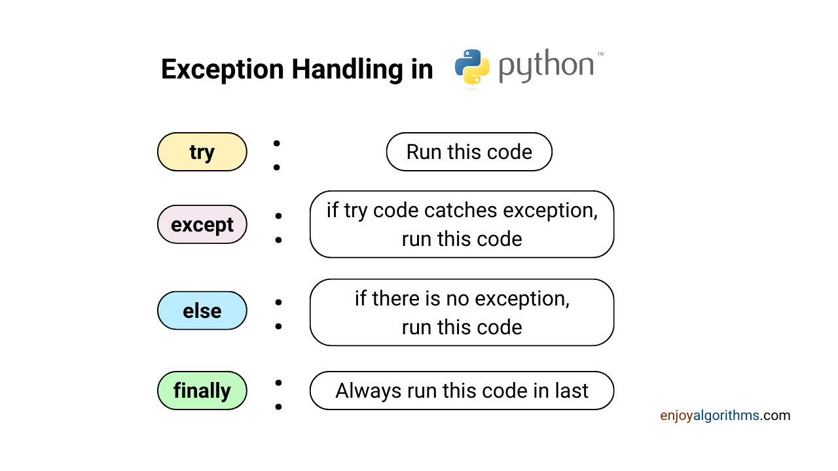
code
try:
# Code that might raise an exception
result = 10 / 0 # Example: ZeroDivisionError
except ZeroDivisionError:
# Code to handle the ZeroDivisionError
print("Cannot divide by zero.")
except TypeError:
# Code to handle a TypeError
print("Type error occurred")
except Exception as e:
# Code to handle any other exception
print(f"An error occurred: {e}")
else:
# Code to execute if no exception occurs
print("No exceptions occurred.")
finally:
# Code to execute regardless of exceptions
print("This always executes.")

Slide 116
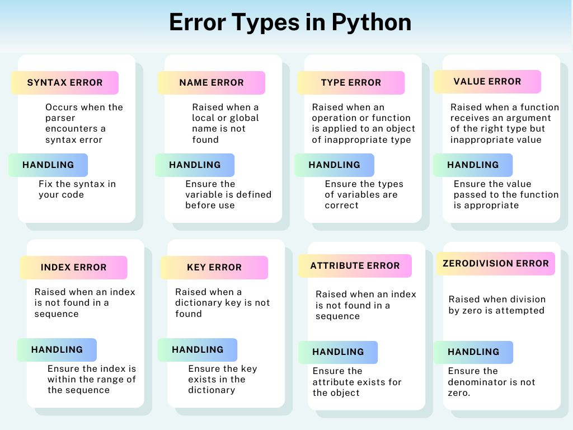

Slide 117
🔹 Common Use Case in Custom Validations:
defdeposit(amount): if amount <= 0: raise ValueError("Deposit amount must be greater than zero.") print(f"Deposited ₹{amount}") deposit(500) # Works fine deposit(-100) # Raises ValueError
✅ raise in Python — Definition and Use
In Python, the raise keyword is used to intentionally trigger (raise) an exception when an error or undesired condition is detected.
SYNTAX
raise ExceptionType("Error message")
🔹 Basic Example:
def divide(a, b): if b == 0: raise ZeroDivisionError("Cannot divide by zero!") return a / b print(divide(10, 2)) # Output: 5.0 print(divide(10, 0)) # Raises: ZeroDivisionError
🔹 Raising Custom Exceptions:
class NegativeAmountError(Exception):
pass
def withdraw(amount):
if amount < 0:
raise NegativeAmountError("Cannot withdraw a negative amount.")
print(f"Withdrew ₹{amount}")
🔹 Why use raise?
To enforce rules in code (e.g., input validation).
To alert developers or users when something unexpected happens.
To prevent further execution when an error state is detected.

Slide 118
🔧 What is Custom Error Handling?
Custom error handling means:
You define your own exception classes.
Use the raise keyword to trigger them when specific conditions occur.
Use try-except to catch and handle them gracefully.
🧱 Step 1: Define Custom Exception Classes
class NegativeAmountError(Exception): """Raised when the amount is negative.""" pass class InsufficientFundsError(Exception): """Raised when trying to withdraw more than the balance.""" pass
✅ Step-by-Step Example: Custom Bank Errors
🎯 Goal:
Build a banking app that:
Raises custom errors like InsufficientFundsError, NegativeAmountError
Uses try-except blocks to handle these

Slide 119
🧱 Step 2: Create a Class that Uses Them
classBankAccount: def__init__(self, name): self.name = name self.balance = 0.0 defdeposit(self, amount): if amount <= 0: raise NegativeAmountError("Deposit amount must be positive.") self.balance += amount print(f"✅ Deposited ₹{amount}. Balance: ₹{self.balance}") defwithdraw(self, amount): if amount <= 0: raise NegativeAmountError("Withdrawal amount must be positive.") if amount > self.balance: raise InsufficientFundsError("Insufficient balance.") self.balance -= amount print(f"✅ Withdrew ₹{amount}. Balance: ₹{self.balance}")
🧪 Step 3: Handle the Custom Errors Using try-except
# Create a new bank account account = BankAccount("Alice") try: account.deposit(1000) account.withdraw(1500) # Triggers InsufficientFundsError except NegativeAmountError as nae: print(f"❌ Error: {nae}") except InsufficientFundsError as ife: print(f"❌ Error: {ife}")
🎯 Exercise for Practice:
Add a method transfer(amount, other_account) with custom InvalidTransferError.
Log all errors with timestamps using the logging module.
Use finally to print "Transaction complete" whether error occurs or not.

Slide 120
# Custom exception
class NegativeExceptionError(Exception):
pass
class BankAccount:
def __init__(self, owner, balance: int):
self.owner = owner
self.__balance = balance
def get_balance(self):
return self.__balance
def deposit(self, amount):
try:
if amount <= 0:
raise NegativeExceptionError("Deposit amount must be positive.")
self.__balance += amount
print(f"✅ Deposited ₹{amount}. Balance: ₹{self.__balance}")
except NegativeExceptionError as e:
print(f"❌ Error: {e}")
print("Deposit method executed.")
def withdraw(self, amount):
try:
if amount <= 0:
raise NegativeExceptionError("Withdrawal amount must be positive.")
if amount > self.__balance:
raise NegativeExceptionError("Insufficient balance.")
self.__balance -= amount
print(f"✅ Withdrew ₹{amount}. Balance: ₹{self.__balance}")
except NegativeExceptionError as e:
print(f"❌ Error: {e}")
print("Withdraw method executed.")
# Testing
a = BankAccount("Raj", 0)
a.deposit(-78) # Error handled
a.deposit(1000) # Success
a.withdraw(2000) # Insufficient balance error handled
a.withdraw(-500) # Negative amount error handled

Slide 121
📚 Summary
Keyword | Purpose
try | Wraps code that might throw error
except | Handles specific or general exceptions
else | Runs when no error occurs
finally | Always runs (error or no error)
raise | Manually triggers an exception

Slide 122
The pass statement is a placeholder that does nothing.
If you want your custom exception InsufficientFundsError to do more — such as display a custom error message — you can override the __init__ or __str__ method. Here's how you can do it:
✅ With Custom Error Message:
classInsufficientFundsError(Exception): def__init__(self, message="Insufficient funds in the account."): self.message = message super().__init__(self.message)
✅ With Dynamic Details (e.g., balance and amount):
classInsufficientFundsError(Exception): def__init__(self, balance, amount): self.balance = balance self.amount = amount message = f"Transaction failed: Tried to withdraw {amount}, but only {balance} is available." super().__init__(message)
Example Usage:
defwithdraw(balance, amount): if amount > balance: raise InsufficientFundsError(balance, amount) return balance - amount # Test try: withdraw(100, 150) except InsufficientFundsError as e: print(e)
This gives you a more informative and practical custom exception than using pass.

Slide 123
File Handling
What is file Handling
Different Modes to Open File
Opening Files in Python
Reading Files in Python -Read,Readline ,Readlines
Writing to the Files in Python -Write ,Writelines
Closing Files in Python
Working with file pointers - Seek ,Tell
Pickling & Unpickling
Exception Handling[try,except,finally)
Assignment
https://www.tutorialspoint.com/python/index.htm

Slide 124
🧾 1. What is File Handling?
File handling in Python is the process of performing operations such as opening, reading, writing, and closing files. It allows programs to store and retrieve data permanently.
Use Case:
Used in applications like log storage, report generation, configuration reading, and persistent data storage.
Business Scenario:
A retail application stores daily sales data in a .txt file. File handling is used to read the data at the end of the day and generate reports.
🧱 Basic Syntax
file = open("filename.txt", "mode") # Perform operations file.close()
🔑 Key File Operations
Operation | Mode | Description
Read | 'r' | Opens a file for reading (default)
Write | 'w' | Opens a file for writing (overwrites)
Append | 'a' | Opens a file for appending
Read/Write | 'r+' | Opens for reading and writing
Binary | 'rb', 'wb' | For binary files like images

Slide 125
📖 2. Reading from a File
f = open("data.txt", "r") print(f.read()) # Read entire file print(f.readline()) # Read one line print(f.readlines()) # Read all lines into a list f.close()
✍3. Writing to a File
f = open("data.txt", "w") # Overwrites file f.write("Hello, Python!\n") f.write("Writing to a file.\n") f.close()
🔥 Tip: If the file doesn’t exist, Python will create it.
➕ 4. Appending to a File
f = open("data.txt", "a") # Adds to the end of file f.write("Adding a new line.\n") f.close()
🔄 5. Using with Statement (Best Practice)
The with block automatically closes the file, even if an error occurs.
python
CopyEdit
withopen("data.txt", "r") as f: content = f.read() print(content) # File is automatically closed here
📊 6. File Object Methods
Method | Description
.read() | Reads entire content
.readline() | Reads single line
.readlines() | Returns list of lines
.write(text) | Writes string to file
.writelines(list) | Writes a list of strings
.close() | Closes the file
.seek(pos) | Moves cursor to position pos
.tell() | Returns current cursor position

Slide 126
🧪 Example: Read & Count Lines
withopen("data.txt", "r") as f: lines = f.readlines() print("Total lines:", len(lines))
🔐 finally Block Use Case
Use it to close files, database connections, or cleanup even if an error occurs.
try: file = open("data.txt") data = file.read() except FileNotFoundError: print("❌ File not found.") finally: file.close() print("🔒 File closed.")
🚨 Exception Handling with Files
try: withopen("info.txt", "r") as f: print(f.read()) except FileNotFoundError: print("❌ File does not exist.")
🗃️ Working with Binary Files
withopen("image.jpg", "rb") as f: data = f.read()
🧹 Deleting a File
import os if os.path.exists("data.txt"): os.remove("data.txt") else: print("File does not exist.")
🔐 Check If File Exists
import os if os.path.exists("data.txt"): print("File is available.") else: print("File not found.")

Slide 127
📂 3. Opening Files in Python
Syntax:
file_object = open("filename", "mode")
Example:
f = open("data.txt", "r")
Use Case:
Loading configuration files or reading logs.
📖 4. Reading Files in Python
📌 read() – Reads the entire content
f = open("data.txt", "r") print(f.read()) f.close()
📌 readline() – Reads one line at a time
f = open("data.txt", "r") print(f.readline()) f.close()
📌 readlines() – Reads all lines into a list
f = open("data.txt", "r") lines = f.readlines() print(lines) f.close()
Business Scenario:
A hospital system reads patient data line by line to avoid loading the entire file into memory at once.
✍️ 5. Writing to Files in Python
📌 write() – Writes string to file
f = open("log.txt", "w") f.write("Daily transaction report") f.close()
📌 writelines() – Writes list of strings
lines = ["First Line\n", "Second Line\n"] f = open("log.txt", "w") f.writelines(lines) f.close()
Business Use Case:
A banking application writes transaction history into log files after every operation.
🔐 6. Closing Files
Syntax:
file_object.close()
Example:
f = open("data.txt", "r") # operations f.close()
Note: Always close files to free up system resources.
Better Practice – Using with:
withopen("data.txt", "r") as f: content = f.read()

Slide 128
🧭 7. Working with File Pointers
📌 tell() – Returns the current file pointer position
f = open("data.txt", "r")
print(f.tell())
📌 seek() – Moves the pointer to a specific location
f.seek(0)
Use Case:
Useful in log analysis when you need to resume reading from a specific byte.
🧺 8. Pickling & Unpickling
Pickling: Serializing a Python object into a binary stream.
Unpickling: Deserializing the stream back into a Python object.
📌 Example:
import pickle # Pickling data = {'name': 'John', 'age': 30} withopen('data.pkl', 'wb') as f: pickle.dump(data, f) # Unpickling withopen('data.pkl', 'rb') as f: result = pickle.load(f) print(result)
Business Scenario:
Saving trained ML models or user sessions.

Slide 129
🛡 9. Exception Handling in File Handling
📌 Try-Except-Finally Structure
try: f = open("data.txt", "r") content = f.read() except FileNotFoundError: print("File not found.") finally: f.close()
Use Case:
Prevent app crash when file is missing, e.g., log file, config file, etc.

Slide 130
📊 Business Scenario Questions
Scenario | Question
Sales Report | How would you read and calculate total sales from a file storing daily transactions?
Log Management | How to append system logs every hour to a file safely using exception handling?
Data Export | How would you store structured JSON or dictionary data to a file and retrieve it later?
Error Log | How can you use file modes and exception handling to record application errors?
File Analysis | How would you extract specific lines from a large log file without reading it all at once?
✅ Summary Table
Topic | Syntax | Use Case
open() | open("file", "r") | Open a file for reading
read() | f.read() | Read full file
readline() | f.readline() | Read line by line
write() | f.write("data") | Write to a file
close() | f.close() | Close the file
seek() | f.seek(0) | Move pointer to start
tell() | f.tell() | Get pointer location
pickle.dump() | Save Python object | Save ML model or config
pickle.load() | Load object from file | Reload object
Exception Handling | try-except-finally | Prevent errors from crashing app

Slide 132
Regular Expressions
Regular Expressions (Regex) Regular Expression, or regex or regexp in short, is extremely and amazingly powerful in searching and manipulating text strings, particularly in processing text files. One line of regex can easily replace several dozen lines of programming codes.
use re module
Regular Expression & WebScraping
Regular Expression & WebScraping
Character Class in Regular Expression
WebScraping using request & beautifulSoup
Assignment
Python Final Assessment
from notebook

Slide 133
What it is:
Data Extraction:
Web scraping automates the process of gathering data from websites.
HTML and Database Access:
Scrapers access and extract both the HTML code and data stored in a website's database.
Automation:
Scrapers are typically automated tools, often using bots or scripts to interact with websites.
Scalability:
Web scraping allows users to efficiently extract large amounts of data from multiple sources.
Various Use Cases:
Extracted data can be used for tasks such as price monitoring, competitor analysis, market research, and data mining.
How it works:
Finding the source:
Scrapers identify the source from which they will extract data, which could be a specific website or a series of websites.
Parsing data:
Scrapers read and filter the extracted data, identifying valuable information.
Outputting data:
The extracted and processed data can be output in various formats, such as CSV, JSON, or spreadsheets, depending on the user's needs.
Web scraping is a process of extracting data or content from a website using automated tools. Unlike screen scraping, which only copies the displayed image, web scraping extracts the underlying HTML code and data stored in a database. This extracted data can then be used for various purposes, such as market research, price monitoring, or data analysis.
Ethical Considerations:
Terms of Service: Web scraping may violate a website's terms of service, potentially leading to legal action.
Resource Overload: Excessive scraping can put a strain on a website's servers.
Data Privacy: Scraping personal or confidential data without proper authorization is unethical and potentially illegal.

Slide 134
1. Core Libraries:
Requests:
This library is used to send HTTP requests to websites, retrieving the HTML content.
Beautiful Soup:
This library parses the HTML content, making it easy to navigate and extract specific data.
Selenium:
This tool automates web browsers. It is useful for scraping dynamic websites that load content with JavaScript.
Scrapy:
A comprehensive framework for building web scrapers that can handle complex tasks.
Playwright:
Similar to Selenium, Playwright automates browsers and supports multiple languages, including Python.
Urllib3:
A powerful HTTP client for Python, used for tasks such as web scraping and API consumption.
2. Web Scraping Process:
Inspect the Website: Use browser tools to understand the website structure and identify the data you need.
Send Requests: Use the requests library to fetch the HTML content of the target page.
Parse HTML: Use Beautiful Soup to parse the HTML and make it traversable.
Extract Data: Select specific HTML elements using CSS selectors or other methods and extract the desired information.
Handle Dynamic Content: For websites that load data with JavaScript, use Selenium or Playwright to interact with the page and get the fully rendered content.
Respect Robots.txt: Check the website's robots.txt file to see if there are any restrictions on scraping.

Slide 135
3. Additional Considerations:
Pagination:
If data is spread across multiple pages, implement logic to navigate through them.
Data Storage:
Decide how to store the extracted data, such as in a CSV file, database, etc.
Ethical Scraping:
Be mindful of the website's terms of service and avoid overloading their servers with too many requests.
Error Handling:
Implement error handling to gracefully manage issues like network errors or changes in the website's structure.

Slide 136
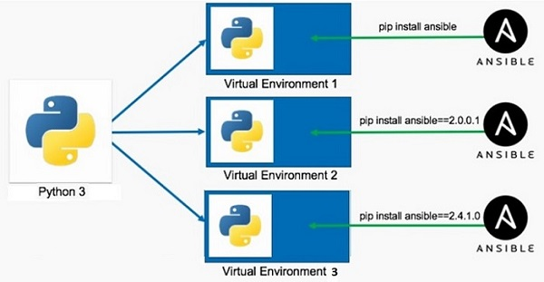
What is Virtual Environment in Python?
A Python virtual environment is:
Considered as disposable.
Used to contain a specific Python interpreter and software libraries and binaries which are needed to support a project.
Contained in a directory, conventionally either named venv or .venv in the project directory.
Not considered as movable or copyable.
https://www.tutorialspoint.com/python/python_virtual_environment.htm

Slide 137
Python Date and Time
Python datetime
Python strftime()
Python strptime()
import os
import sys
List comprehension
Python Lambda/Anonymous Function
Python Iterators
Python Generators
Python Namespace and Scope
Python Closures
Python Decorators
Python @property decorator
Python RegEx
https://www.programiz.com/python-programming/list-comprehension
Precedence and Associativity of Operators in Python
Python Keywords and Identifiers
Python Asserts
Python Json
Python pip
Python *args and **kwargs
sql connector
https://www.w3schools.com/python/python_mysql_getstarted.asp
https://www.w3schools.com/python/python_mongodb_getstarted.asp
https://github.com/GoogleCloudPlatform/cloud-sql-python-connector
https://medium.com/learning-sql/python-for-sql-an-introduction-to-database-connectivity-e1a692e16156
https://cloud.google.com/blog/topics/developers-practitioners/how-connect-cloud-sql-using-python-easy-way
https://stackoverflow.com/questions/73493052/how-to-connect-to-cloud-sql-using-python

Slide 138
Thank You !

Slide 139
Logging
mysql connector
sql lite
sqlalchemy
pymongodb
Pipelines
os
sys
frozen set
ms- excel file read
functions : zip ,map,reduce,filters,any, chr,ord, sorted,global, local,all
reading pdf
call by value call by reference, passing args by value or pass by regerence
create modules
create packeges
create exe file
create python script file
77. Tutorial 77-Python Module
78. Tutorial 78-Executing Module as Script
79. Tutorial 79-Python Loading Modules
80. Tutorial 80-Namespace And Scoping
81. Tutorial 81- Packages in python

